Slide 1


Slide 2

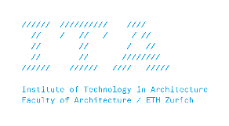



MAS in Architecture and Digital Fabrication MAS ETH DFAB

Slide 3
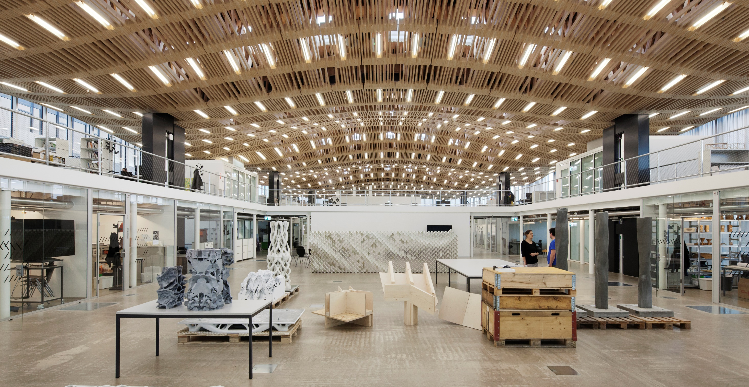
The Arch_Tec_Lab (HIB), home of the Institute of Technology in Architecture (ITA) and the NCCR DFAB

Slide 4
MAS ETH DFAB
The Master of Advanced Studies in Architecture and Digital Fabrication is an intensive twelve-month postgraduate programme run jointly by Digital Building Technologies and Gramazio Kohler Research.
The curriculum combines two of the most rapidly developing fields in architecture: 3D printing and robotic fabrication.
It equips students with the technical, intellectual and artistic skills to master the digital chain from computational design to full scale building tasks.

Slide 5
The Structure of the MAS DFAB in Highlights

Slide 6
The MAS Year 2019-2020
Trimester 1 September 16. – December 20.
Digital Foundations
Trimester 2 January 06. – June 05.
Design and Fabrication Project 1 - GKR
Design and Fabrication Project 2 - DBT
Trimester 3 June 15. – September 25.
Research - Master Thesis

Slide 7
The MAS Year 2018-2019
Trimester 1 September 16. – December 20.
Digital Foundations
Basics
Mini Project GKR (4)
Mini Project DBT (4W)

Slide 8
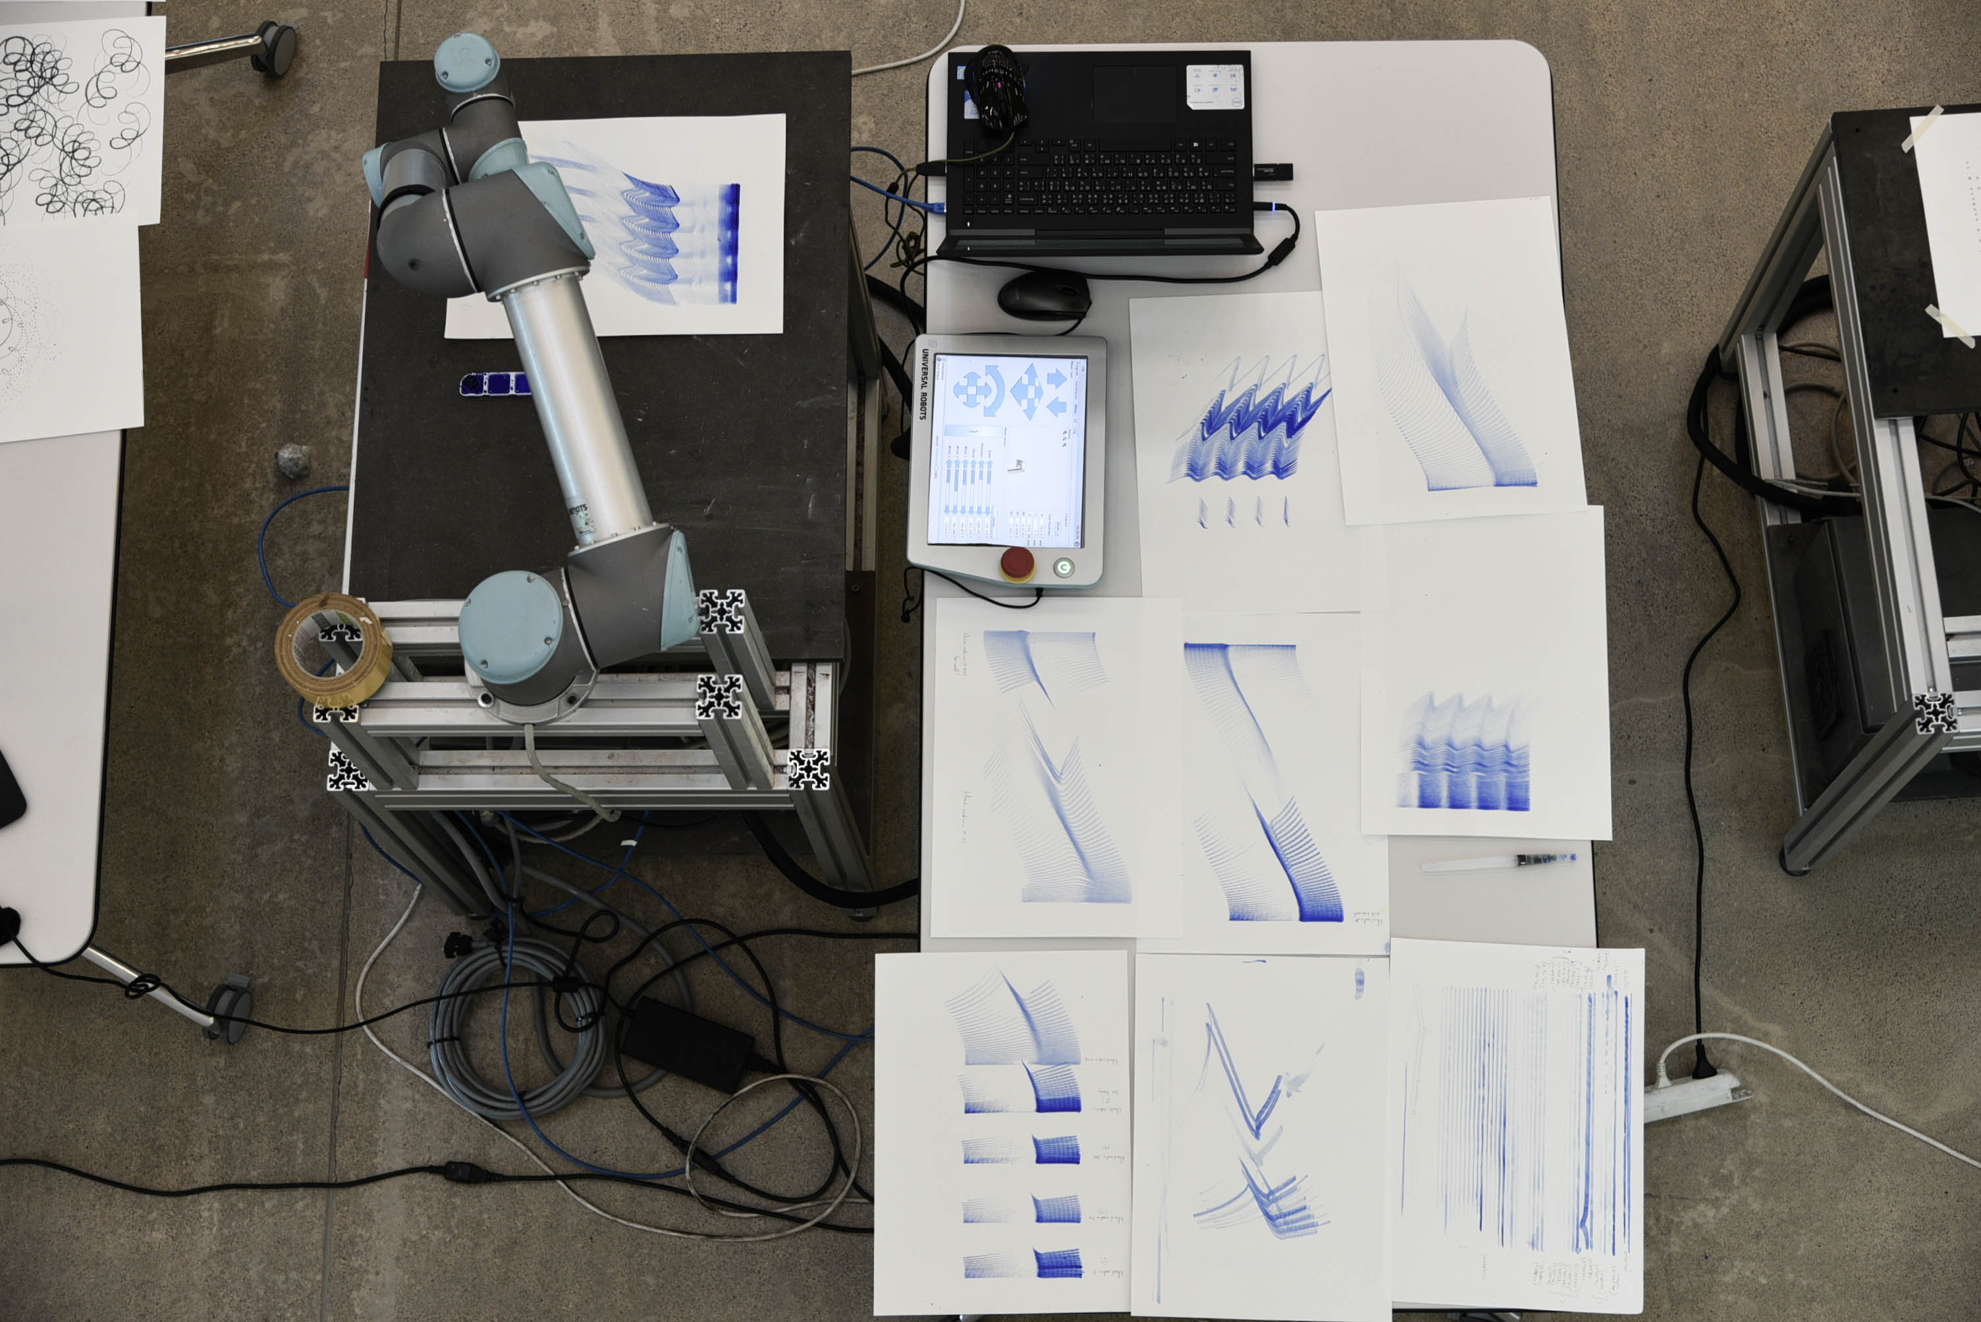
reviews as exhibitions

Slide 9
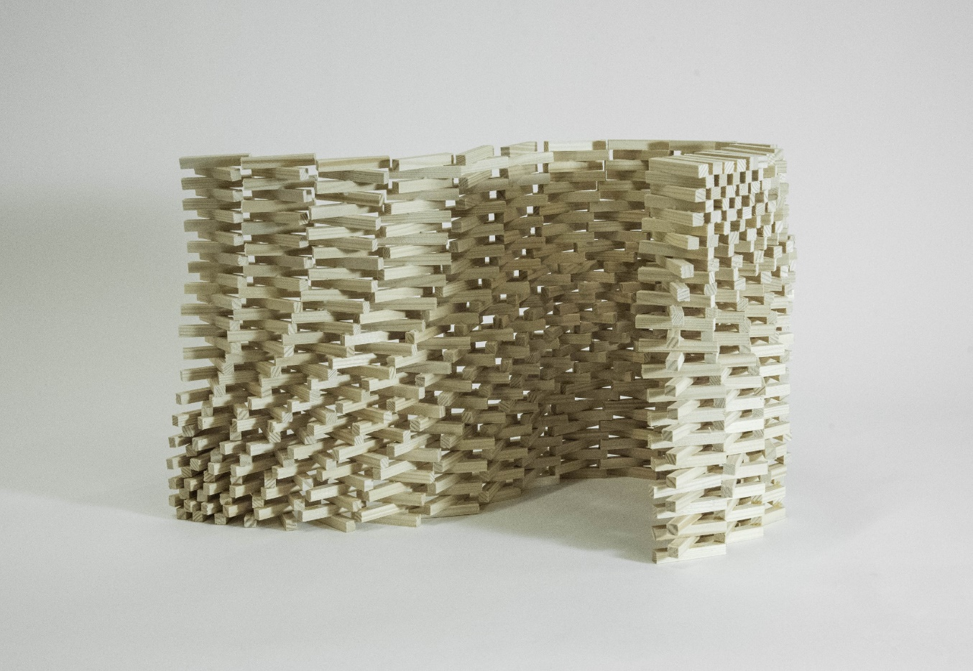
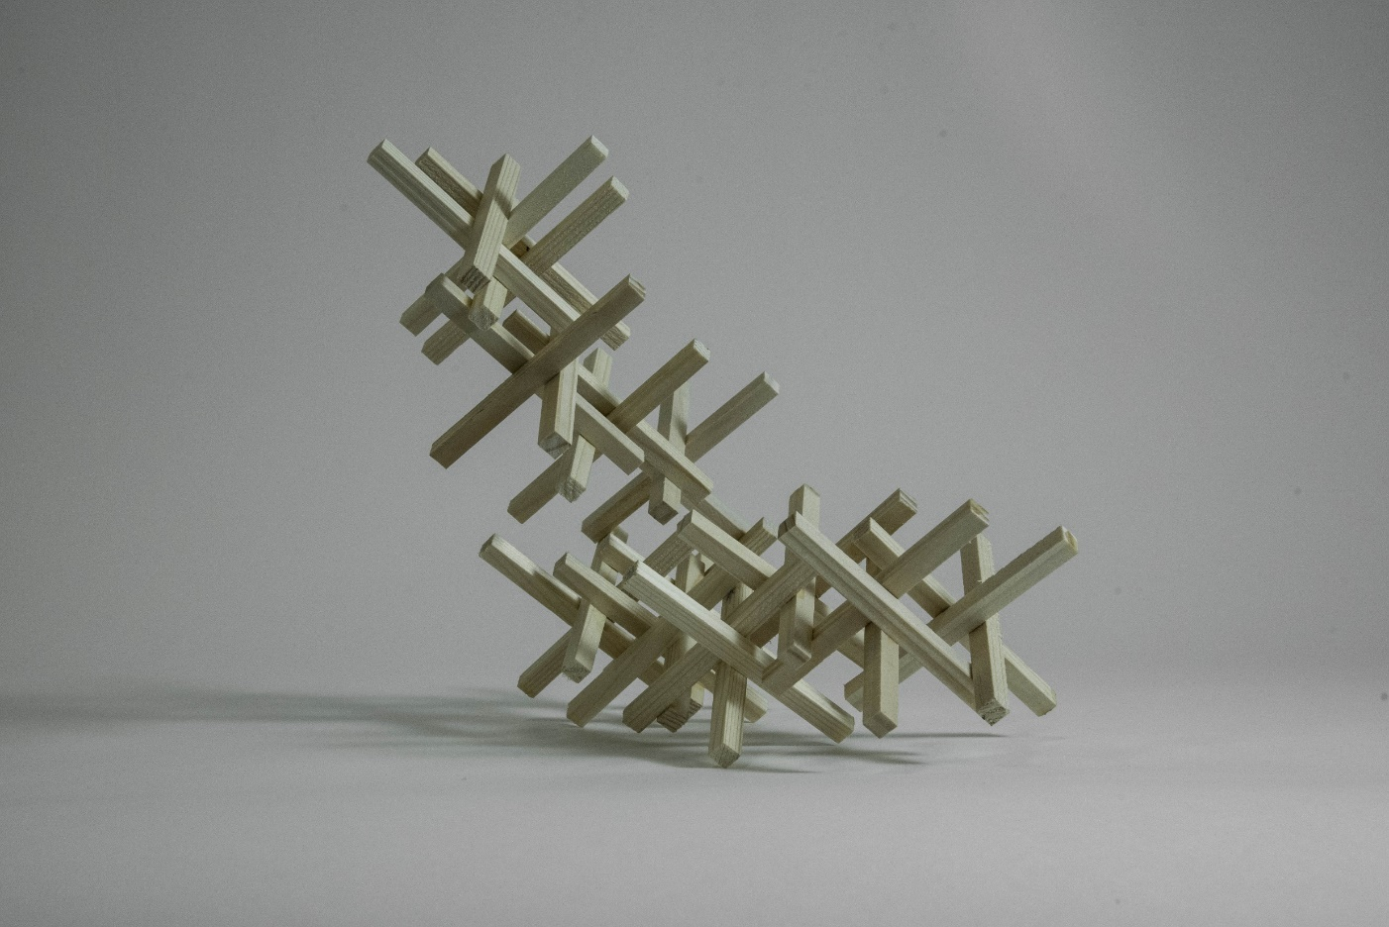

Slide 10
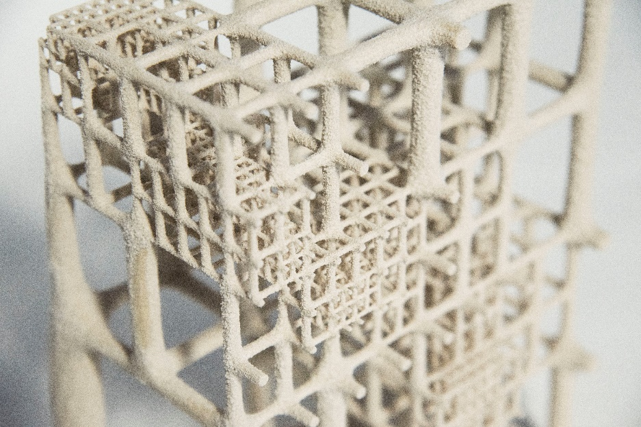
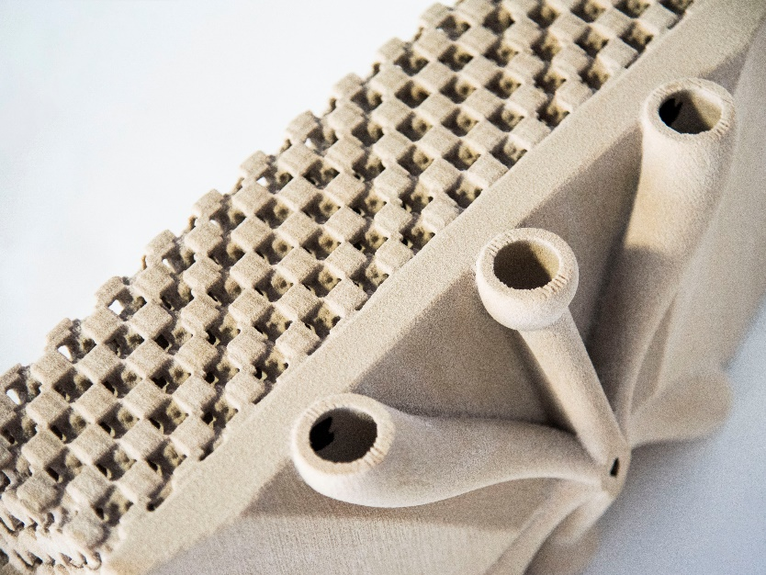
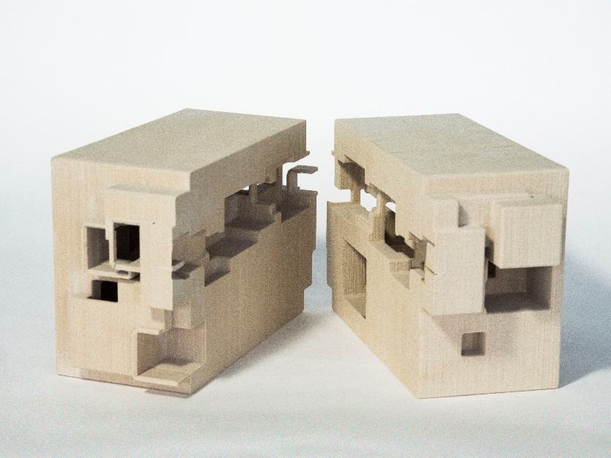
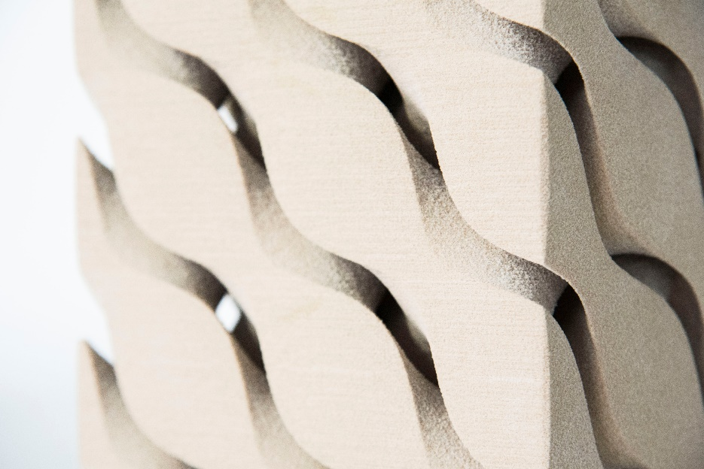
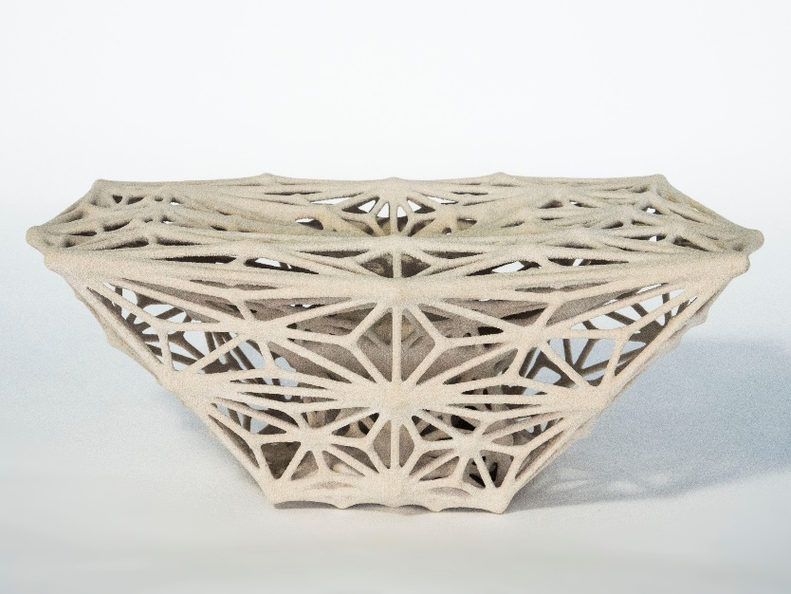
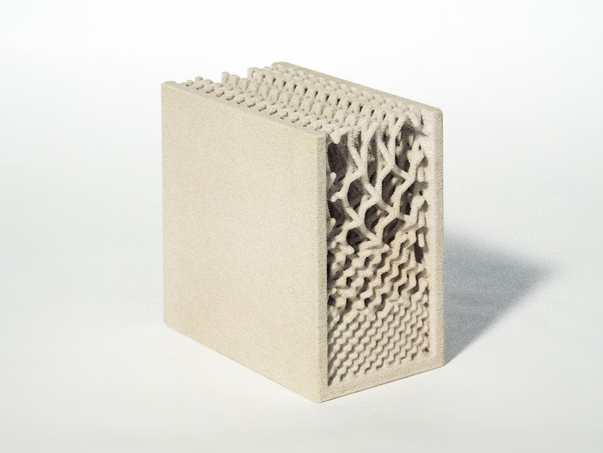

Slide 11
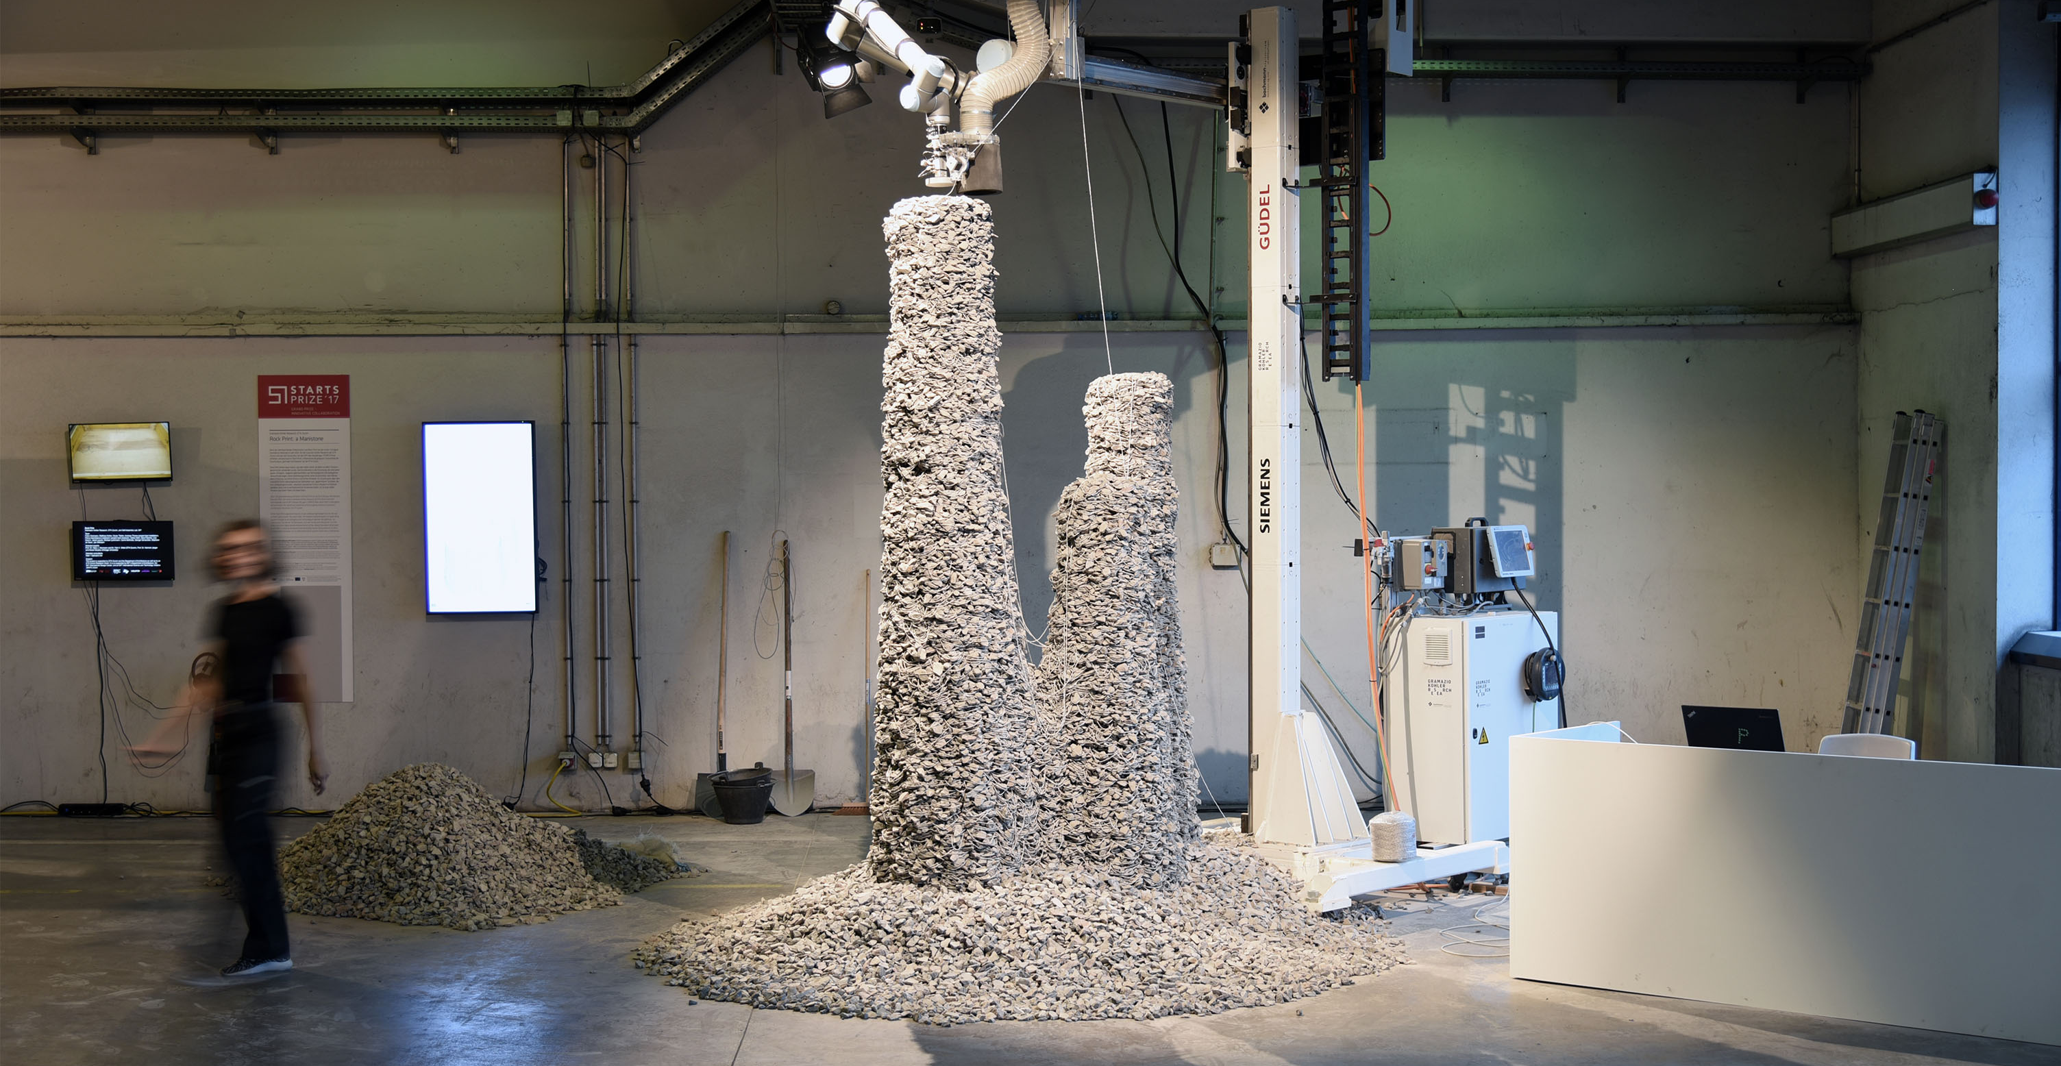
Mesh Mould
Qui facilisi esse nibh veniam velit.

Slide 12
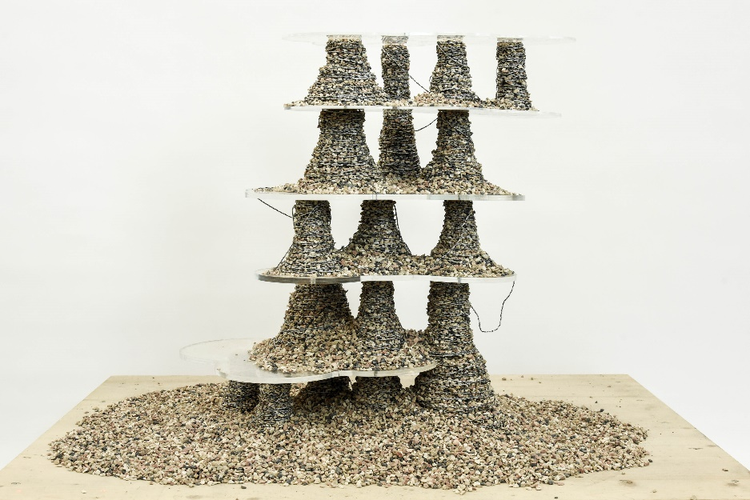
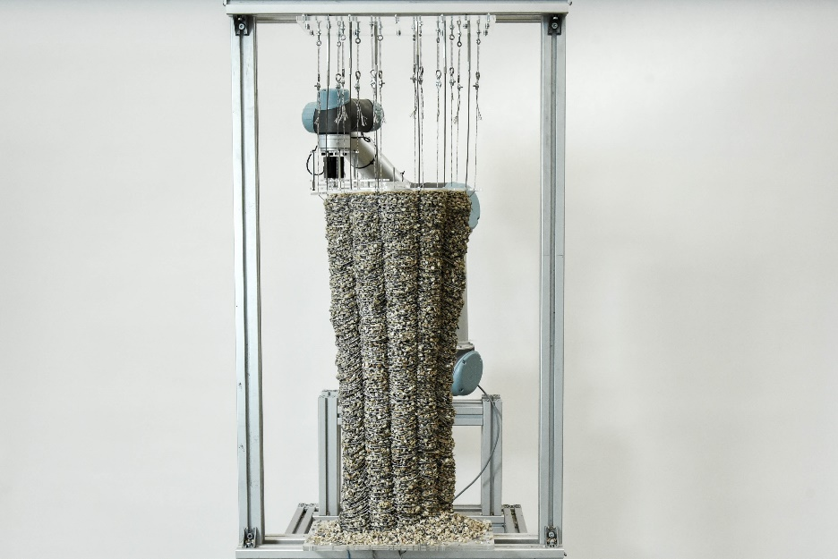
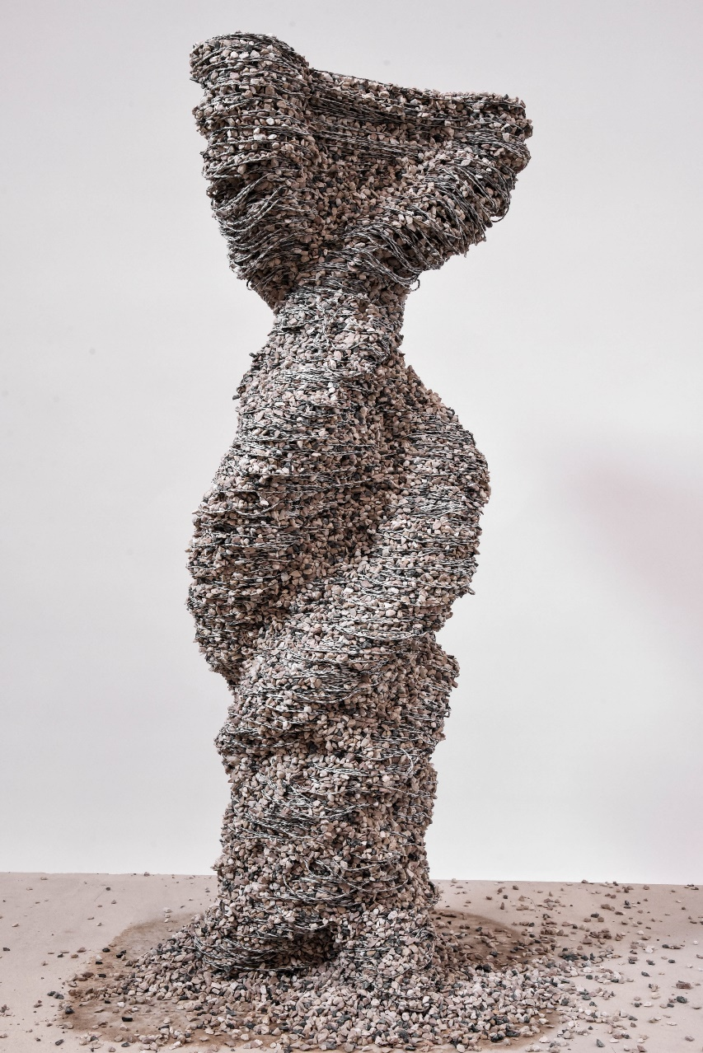
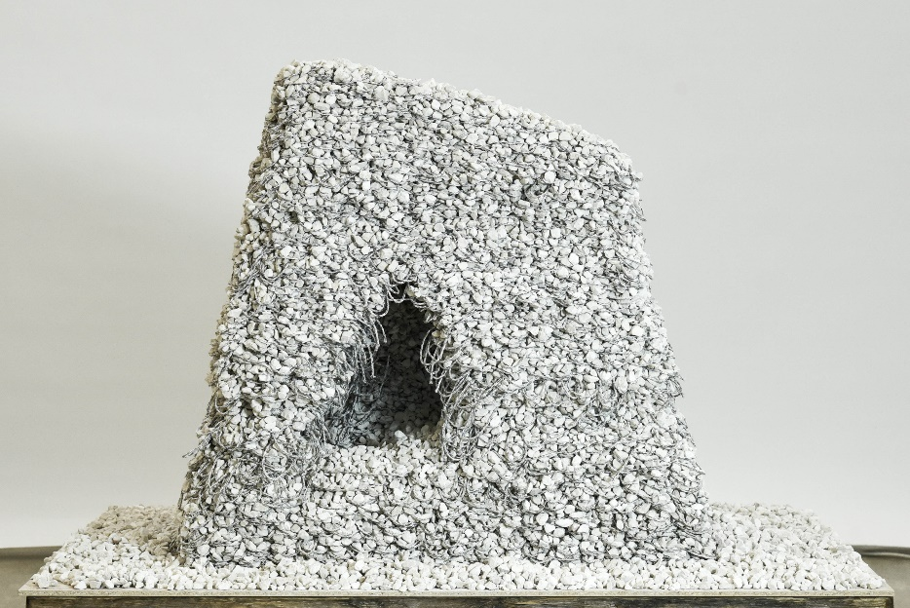
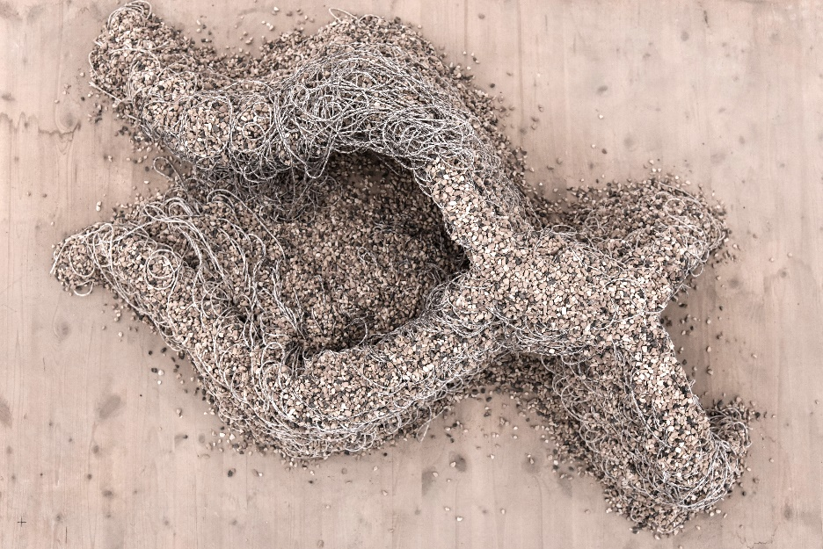

Slide 13
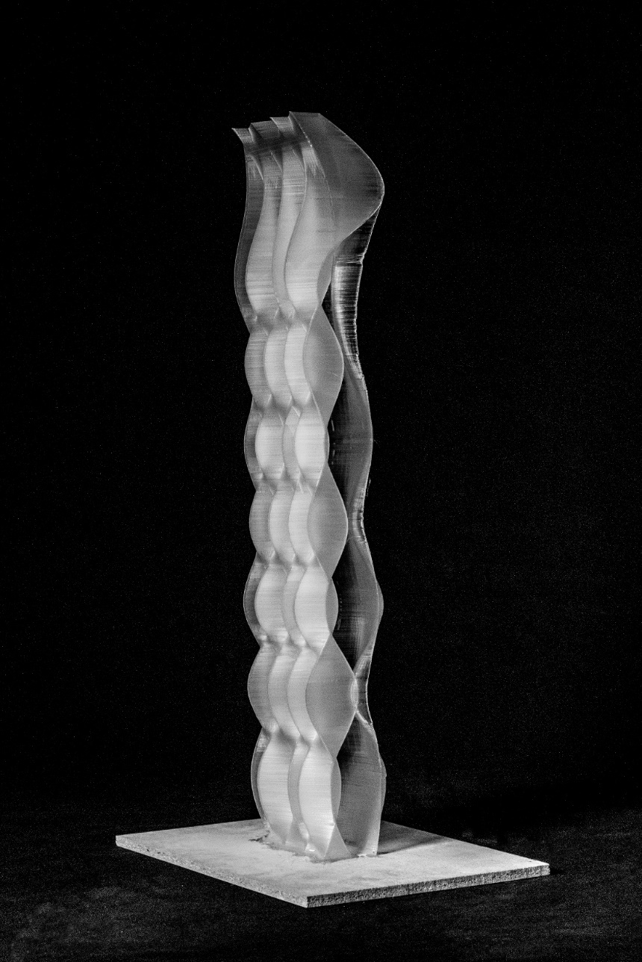

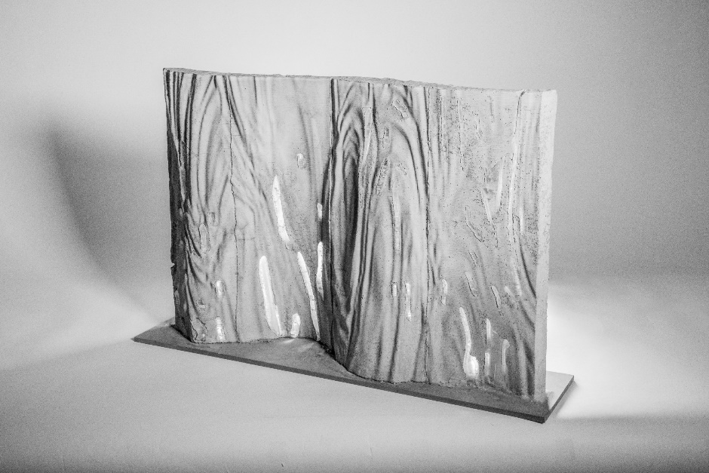
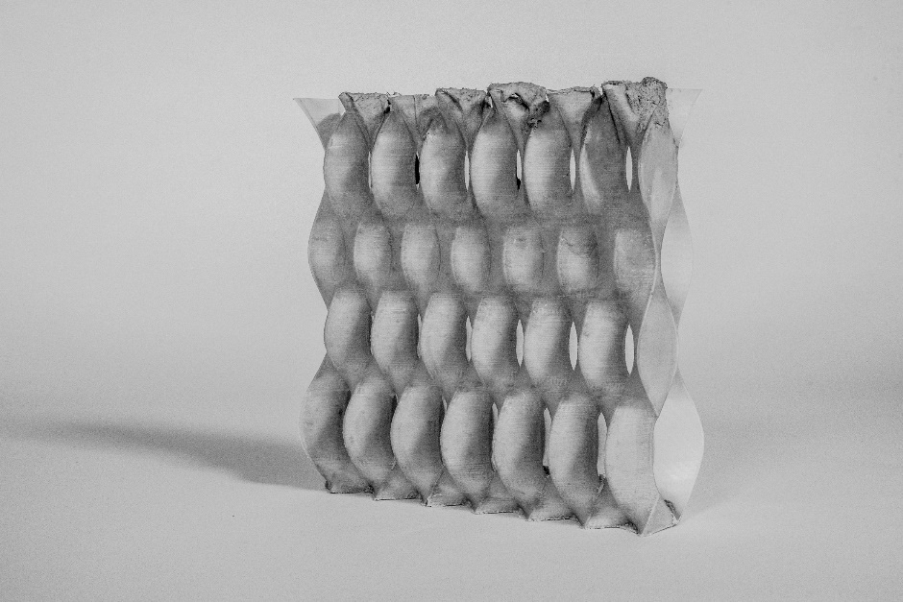
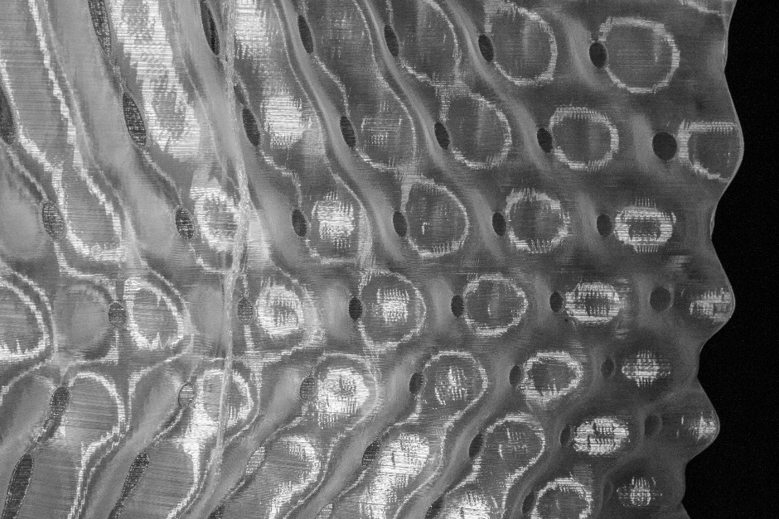

Slide 14
The MAS Year 2018-2019
Trimester 1 September 16. – December 20.
Digital Foundations
Trimester 2 January 06. – June 05.
Design and Fabrication Project 1 - GKR
Design and Fabrication Project 2 - DBT
Trimester 3 June 15. – September 25.
Research - Master Thesis

Slide 15
MAS ETH DFAB: The Design and Fabrication Project
The second trimester of the MAS programme is split into two consecutive full-scale design and fabrication projects. The students work collaboratively on all aspects from computational design to the digital and robotic fabrication of their 1-1 scale structure. They acquire in-depth knowledge and experience in the project management of digitally driven construction projects and develop integrated digital fabrication processes at the forefront of architecture.
In the past years this has resulted in the double-storey Robotic Timber Pavilion, Liquid Metal Pavilion, the Brick Labyrinth, Gradual Assemblies for the Istituto Svizzero in Rome, Concrete Choreography for the Origin Festival in Rio and Up-Sticks for the V&A museum in Dundee.
These projects have underlined the position of the MAS ETH DFAB as a world-leading post-graduate Master programme in the field of digital fabrication in architecture. Several international publications have underlined the highly innovative character of all projects.

Slide 16
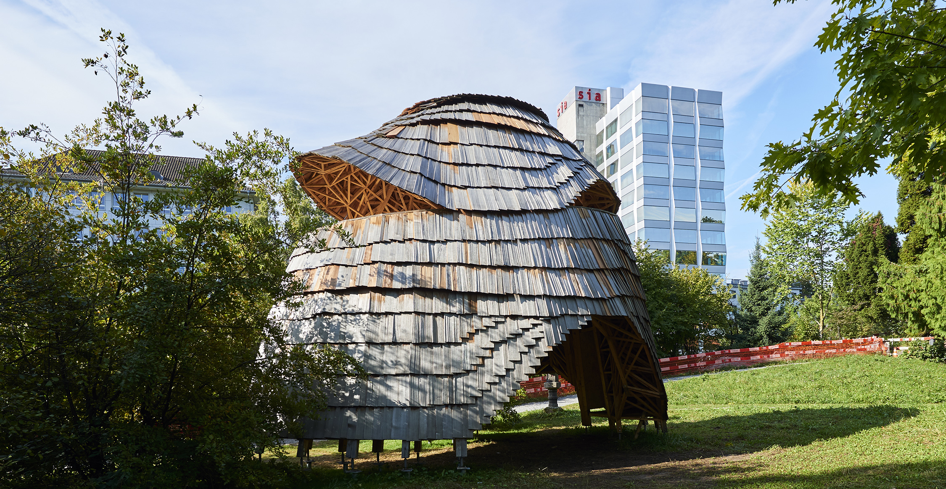
Brick Labyrinth, ETH Zurich

Slide 17
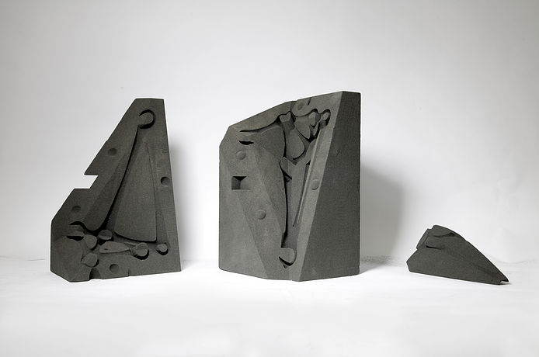
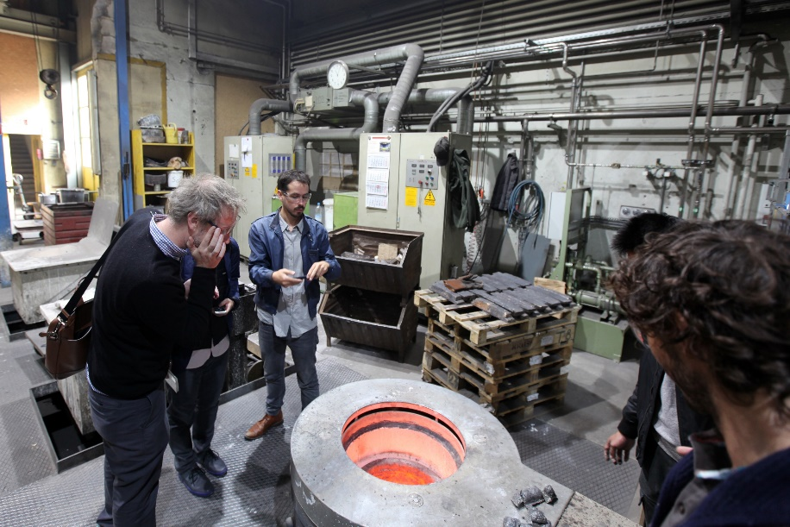
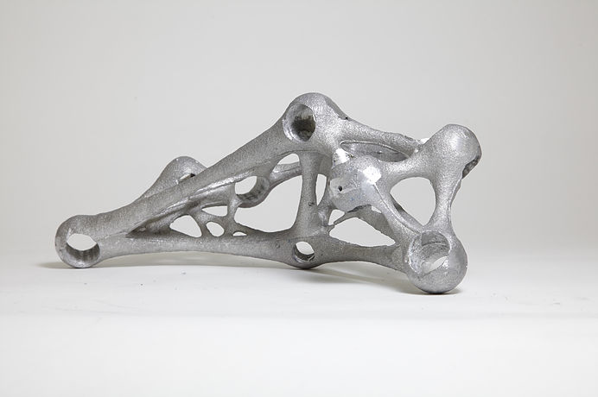

Slide 18
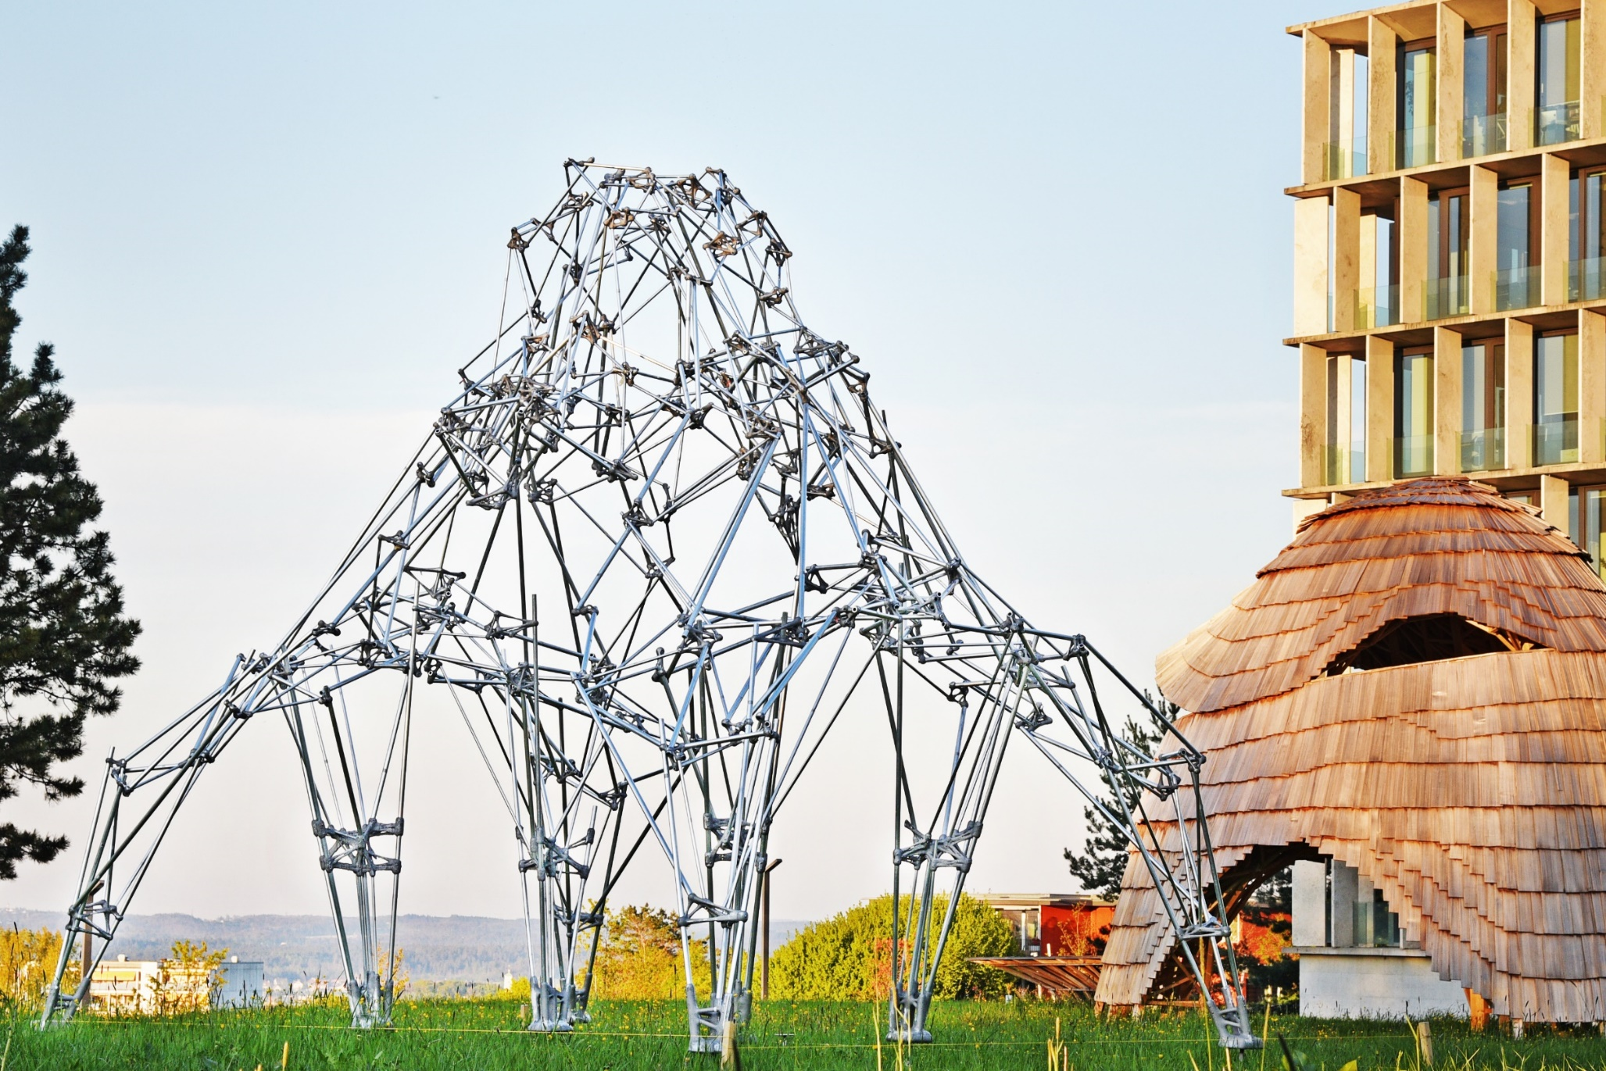
reviews as exhibitions

Slide 19
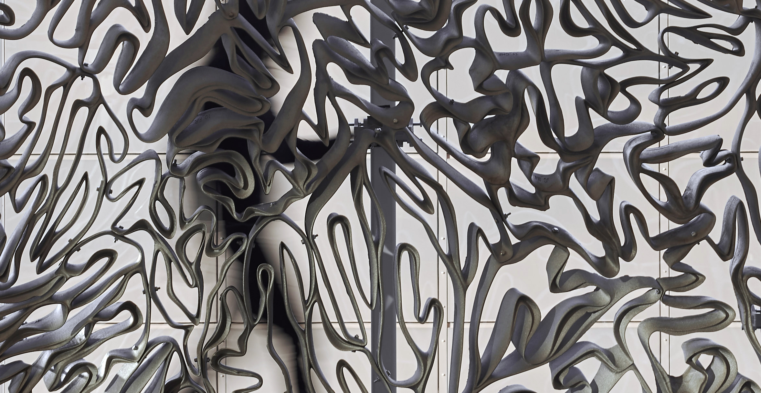
Brick Labyrinth, ETH Zurich

Slide 20
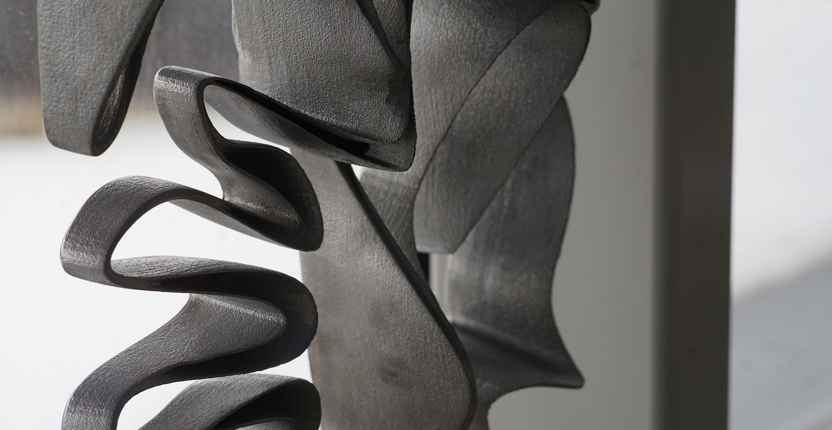
Brick Labyrinth, ETH Zurich

Slide 21
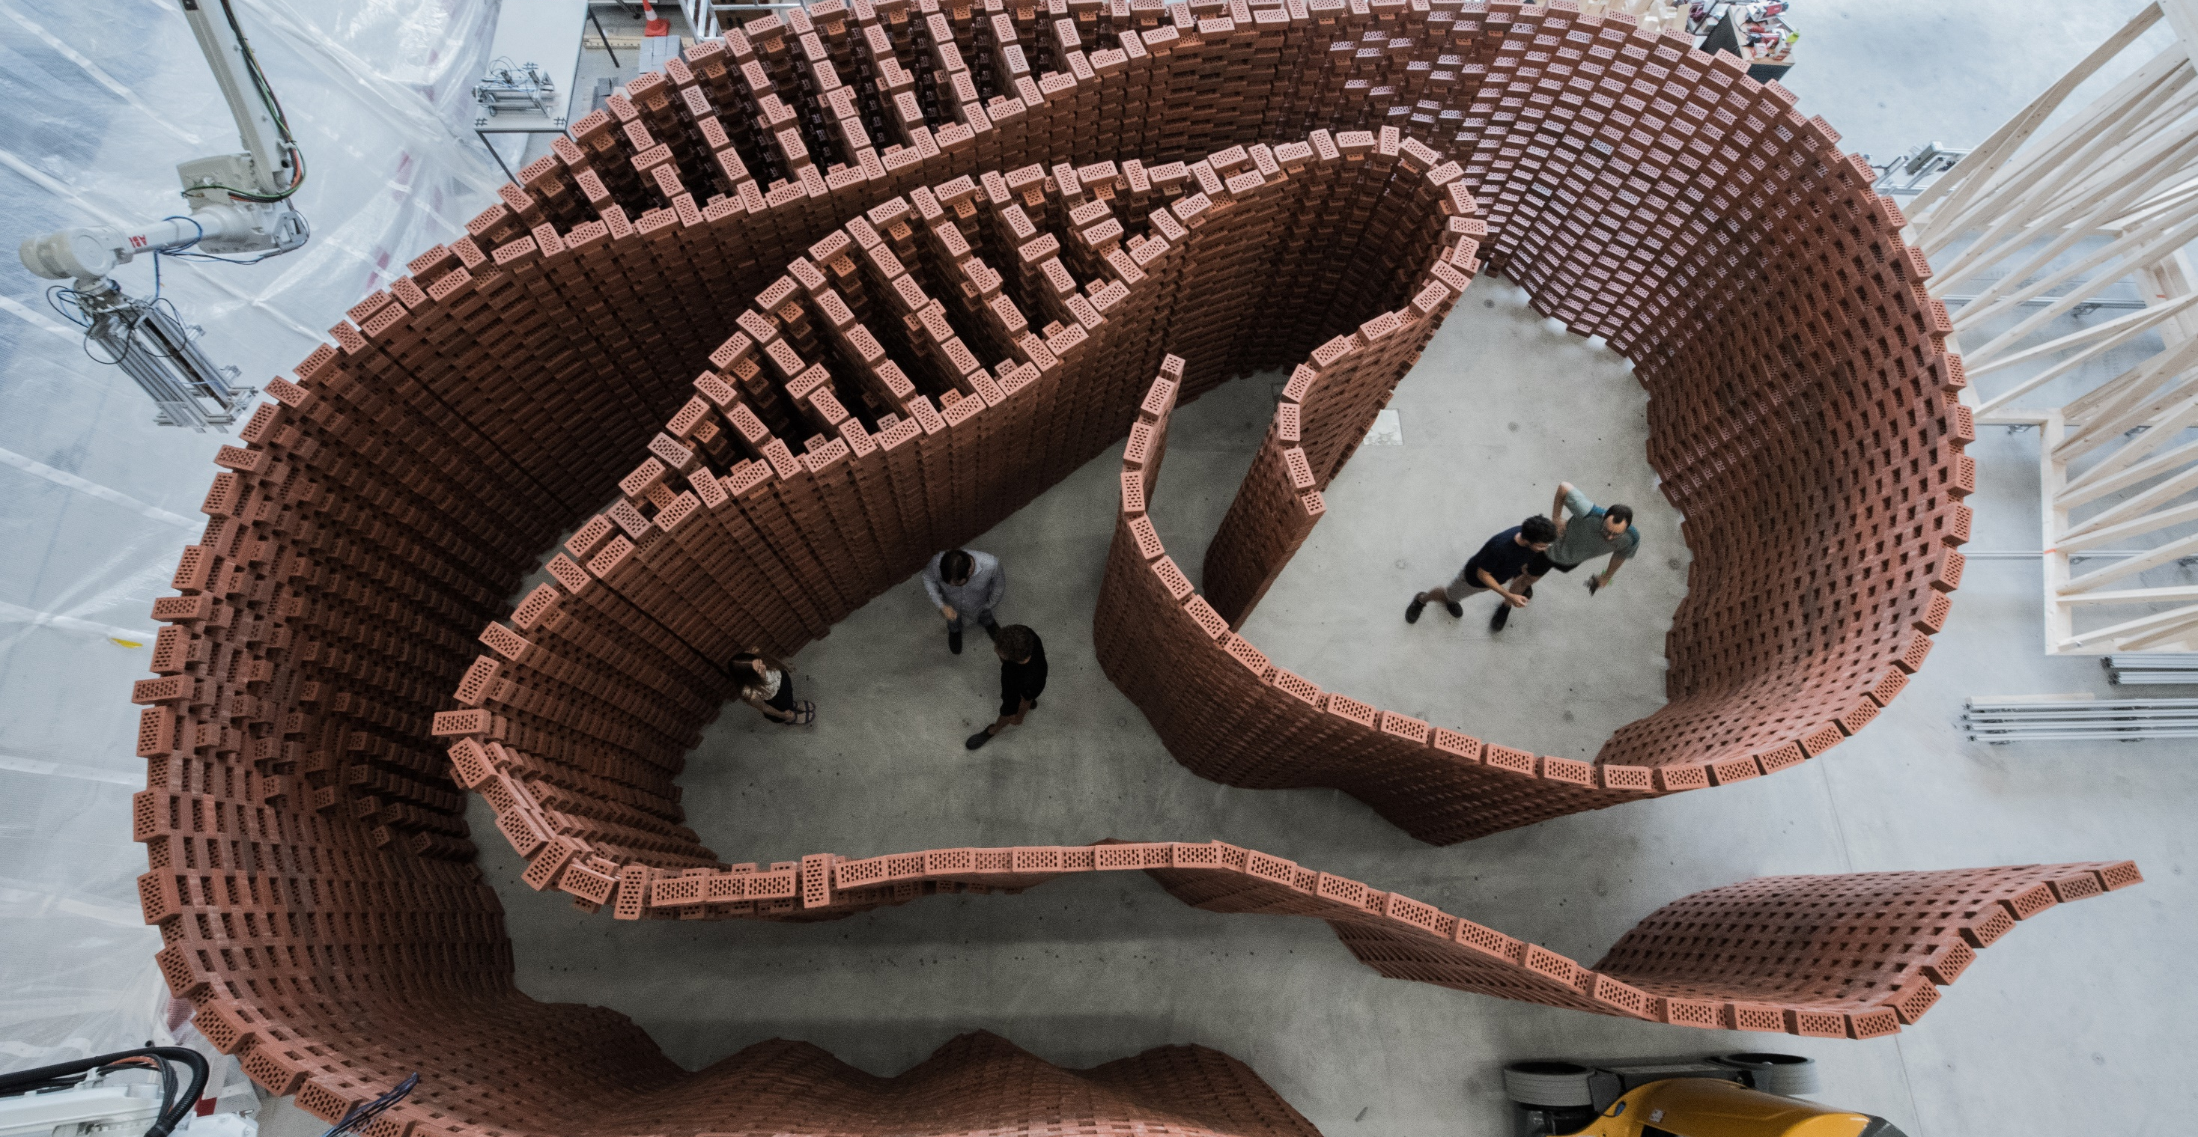
Brick Labyrinth, ETH Zurich

Slide 22
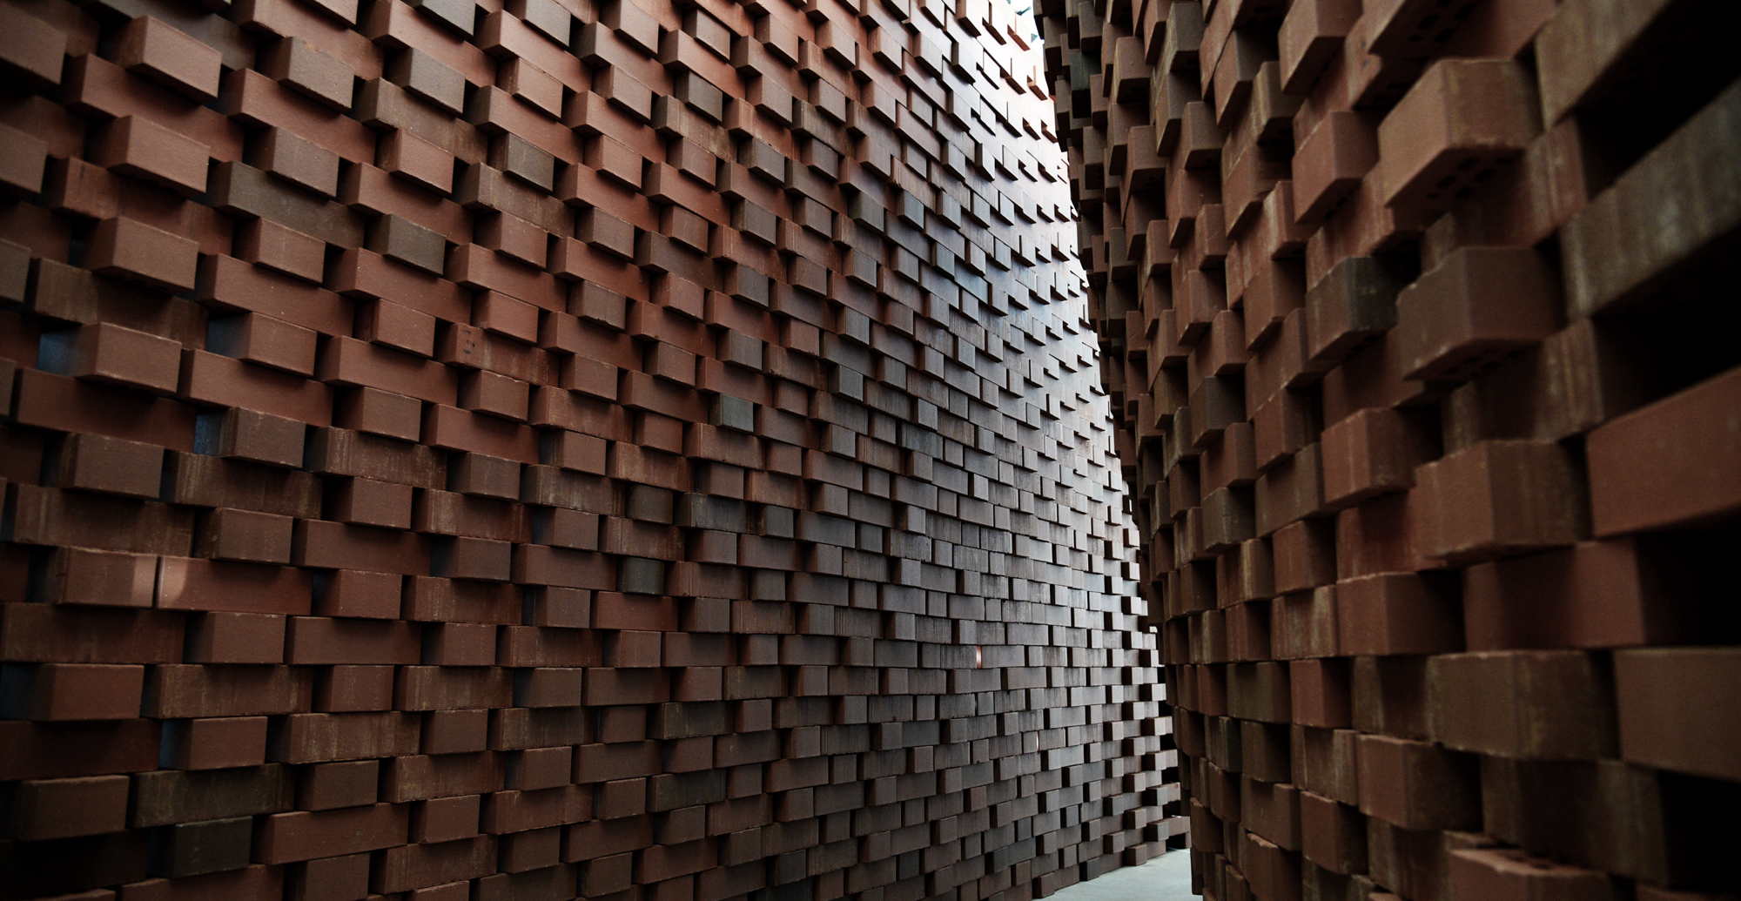
Brick Labyrinth, ETH Zurich

Slide 23
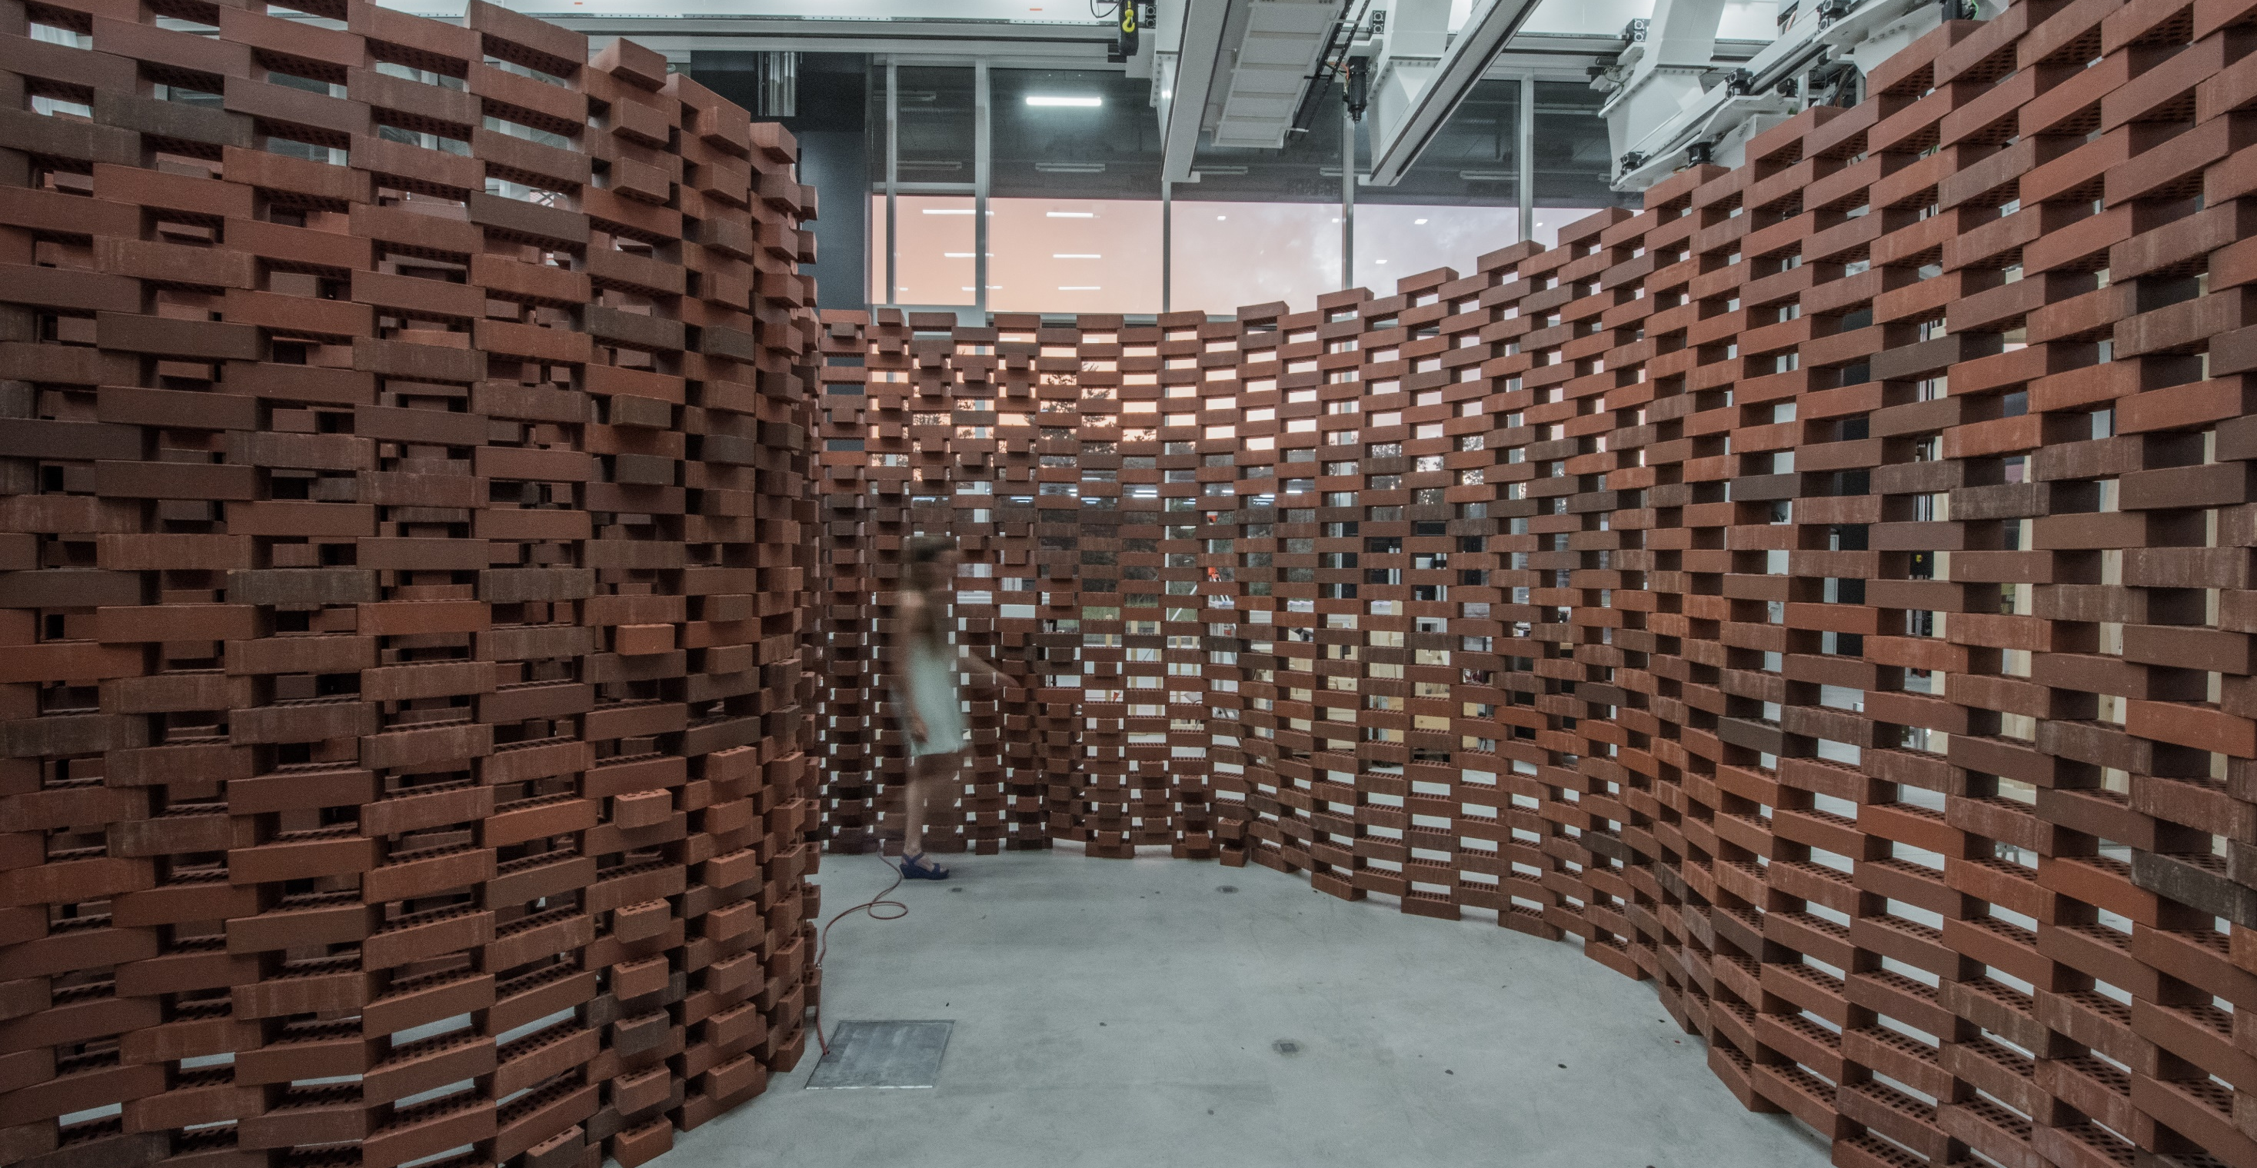
Brick Labyrinth, ETH Zurich

Slide 24
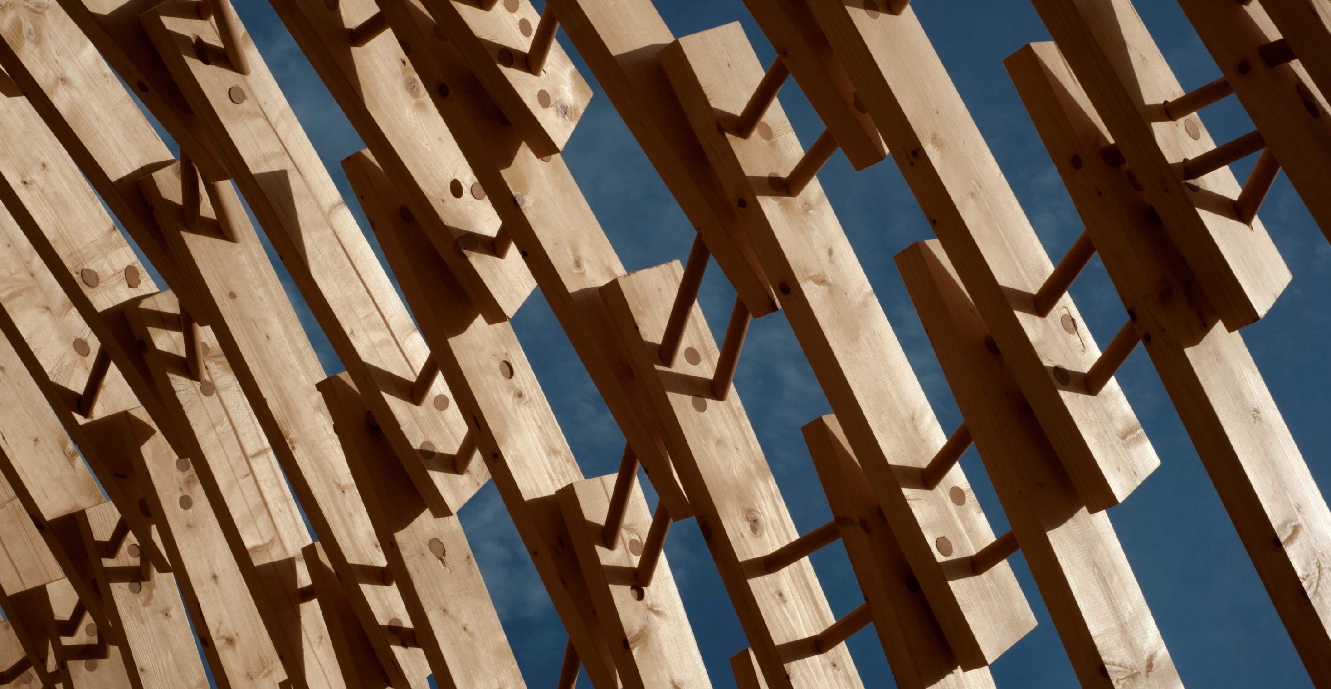
Brick Labyrinth, ETH Zurich

Slide 25
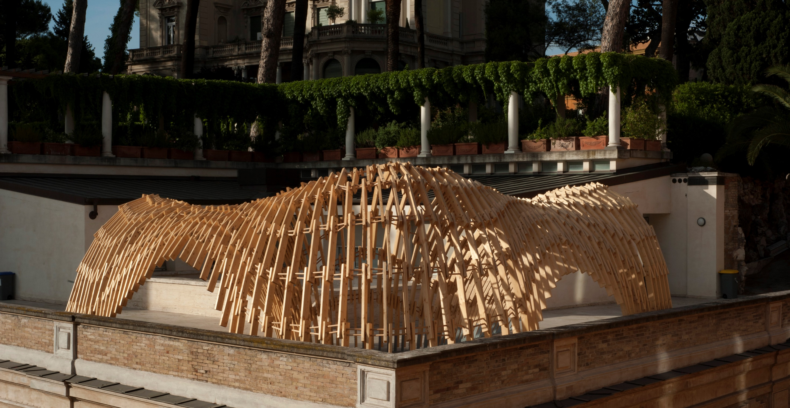
Brick Labyrinth, ETH Zurich

Slide 26
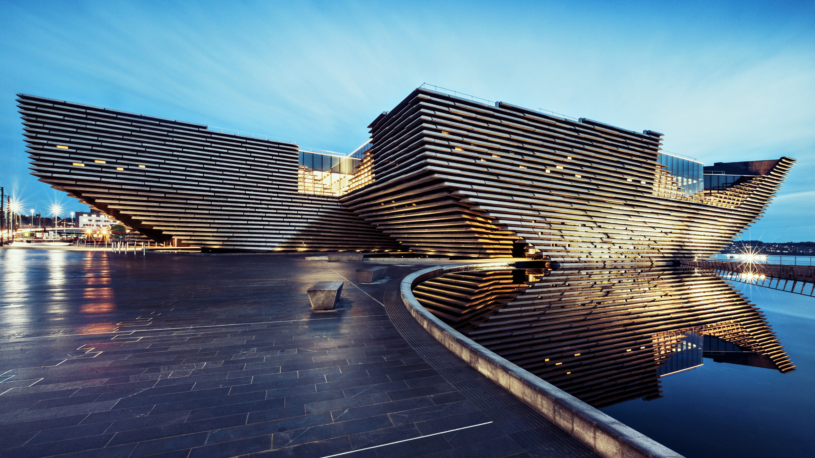
V&A Dundee, image from arup.com, © Ross Fraser McLean

Slide 27
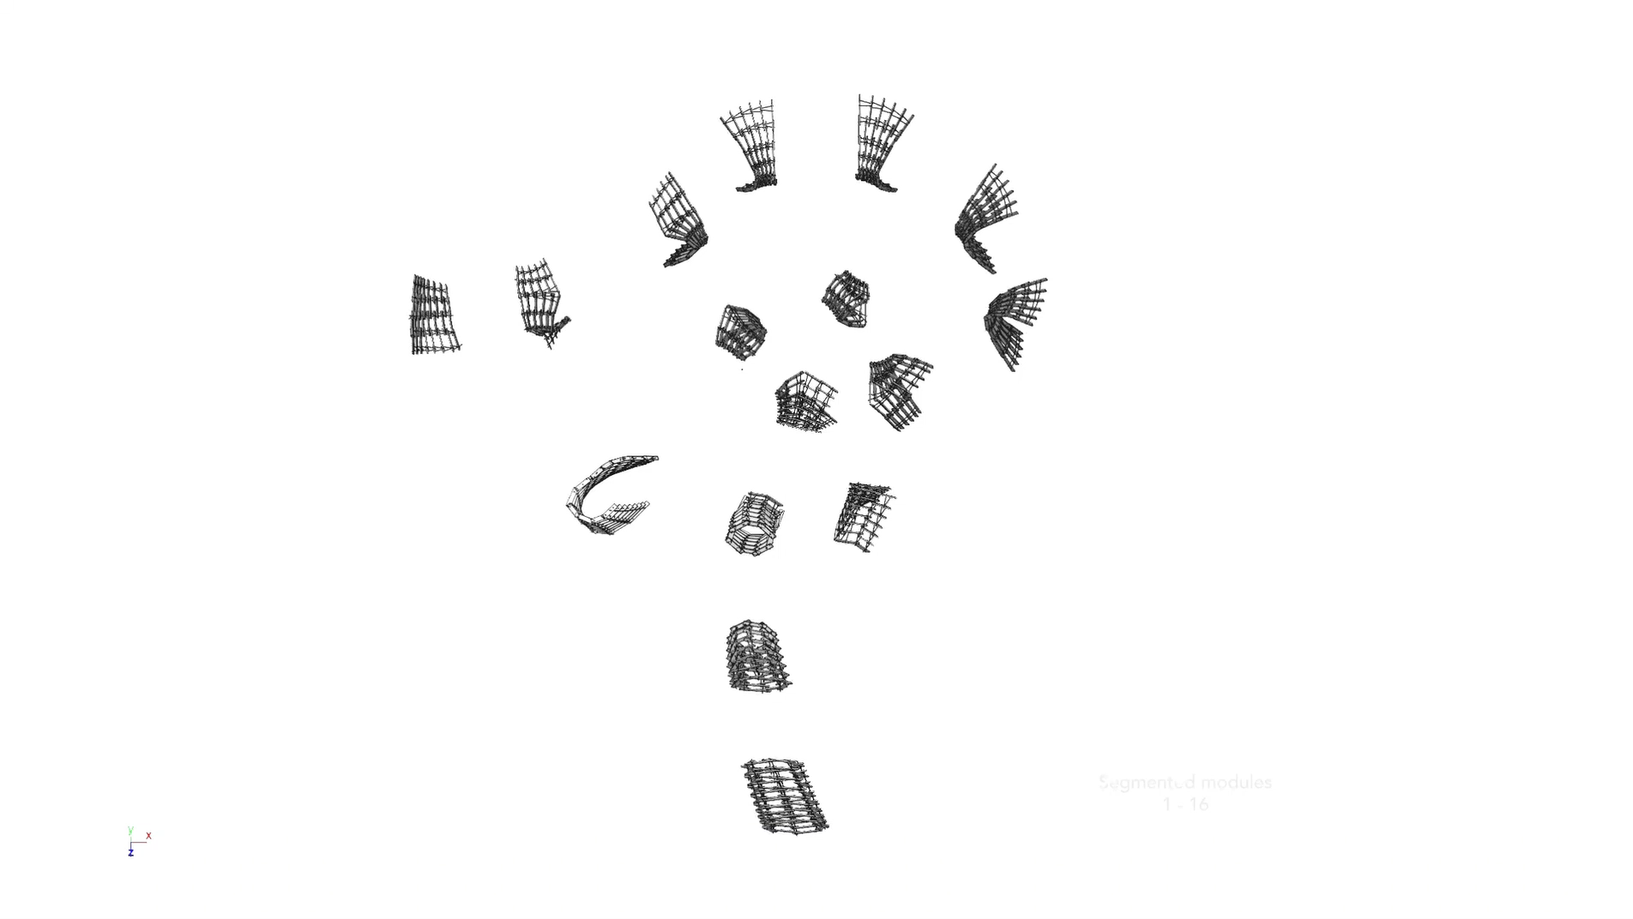

Slide 28
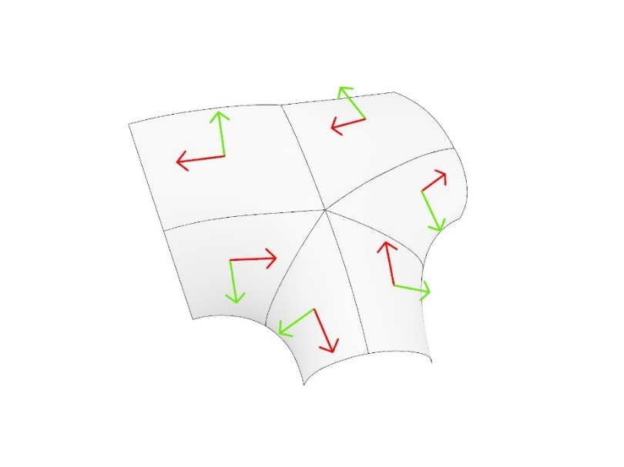
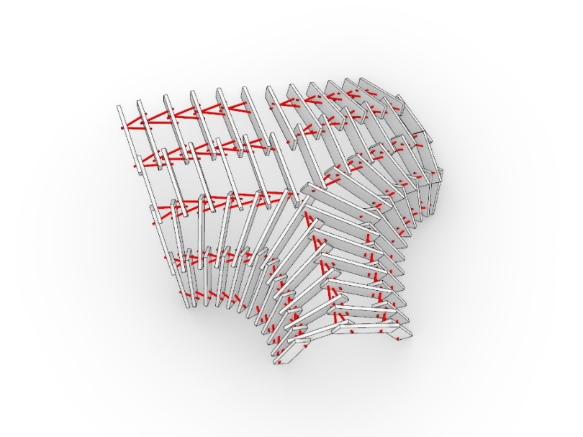
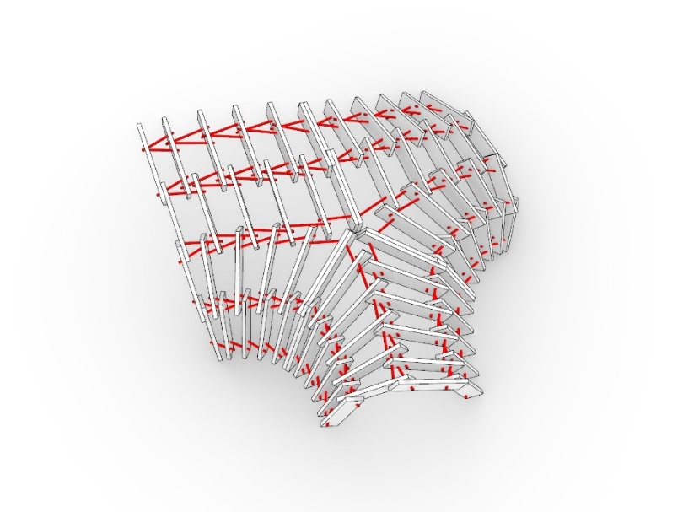

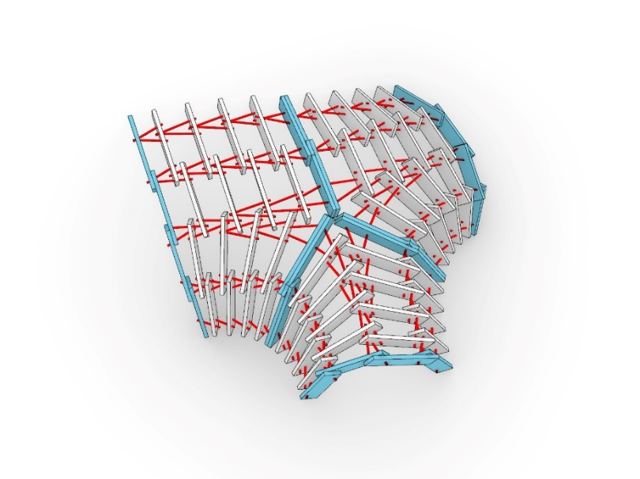
Surface domains (UV), 6 base surfaces
Alignment problems between surfaces
Flipping directionalities
Additional dowel connections
Seams between three modules
Distribution along a seam between three modules, flipping of directionality and generation of additional dowel connections

Slide 29
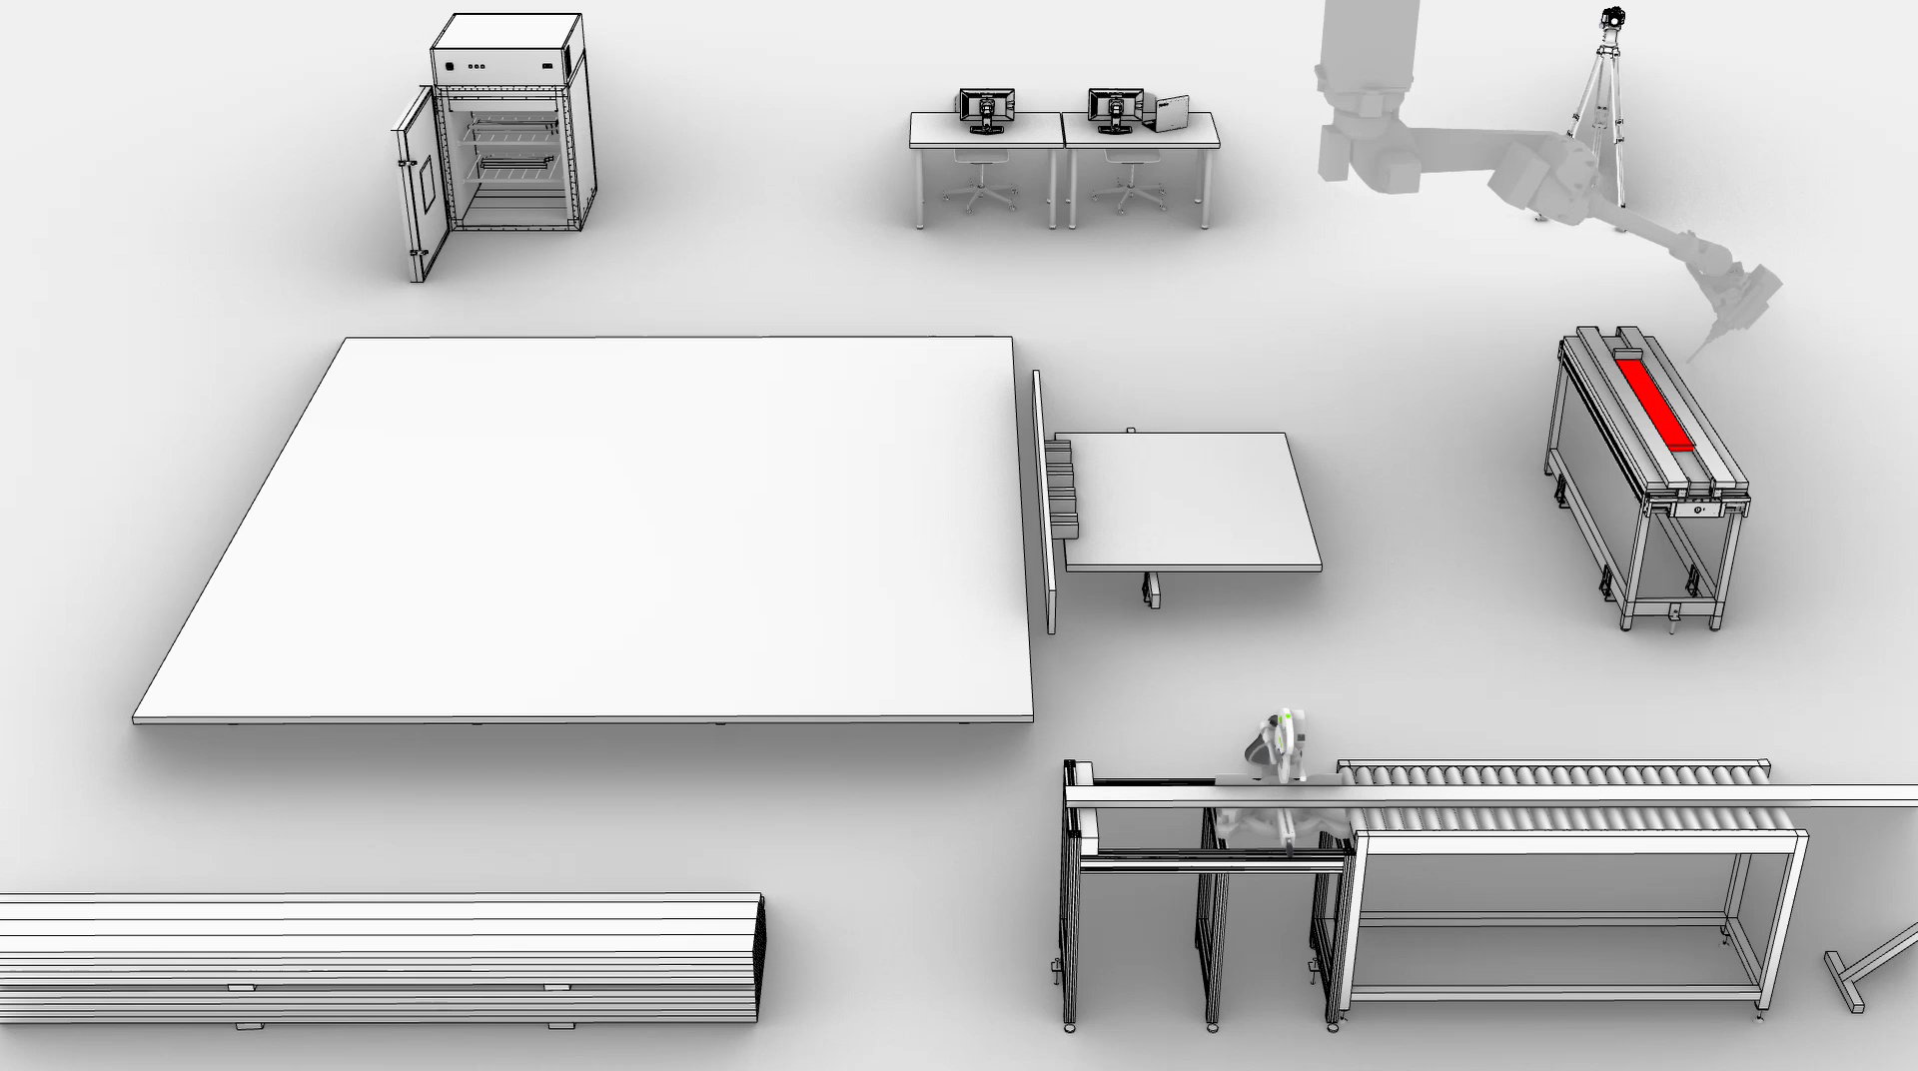
Fabrication sequence of one module

Slide 30
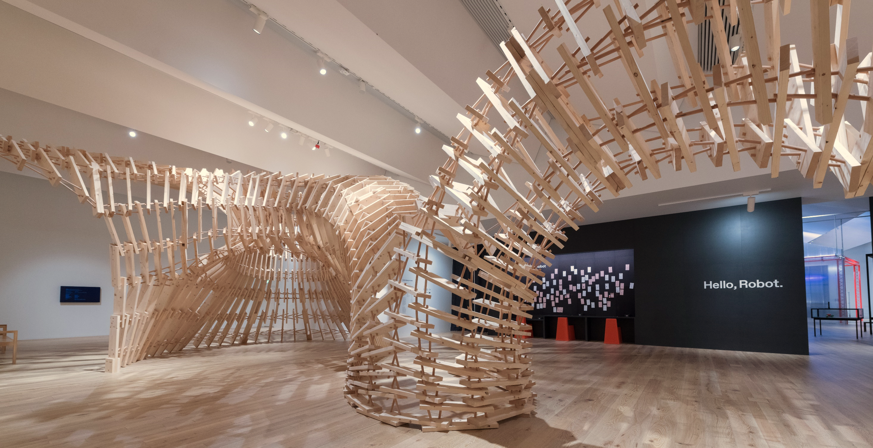
Up Sticks, V&A Dundee

Slide 31
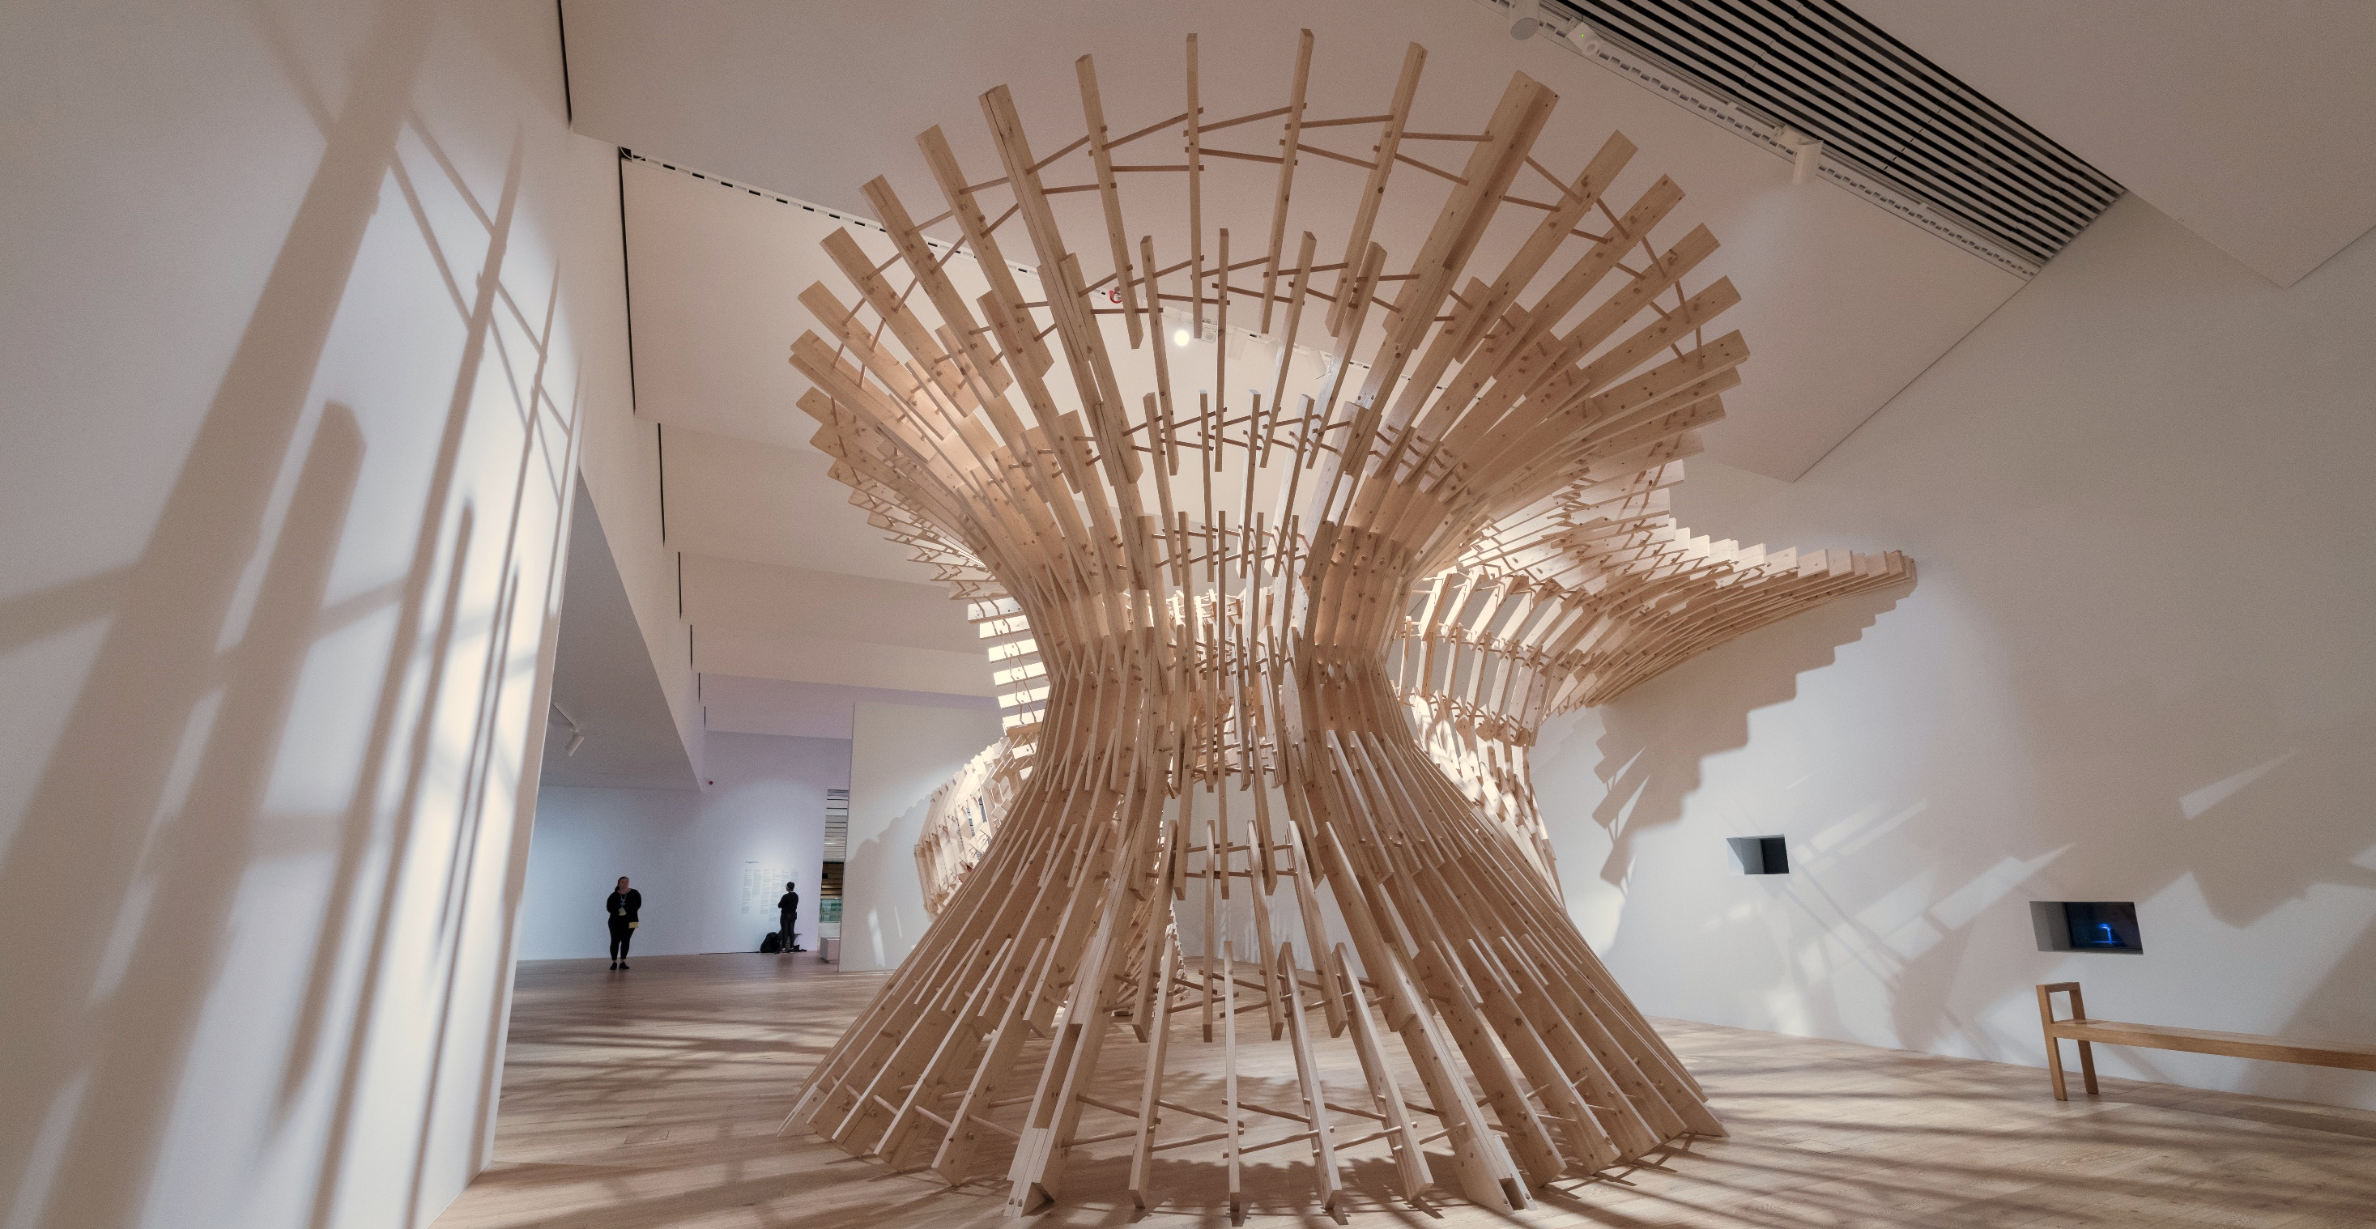
Up Sticks, V&A Dundee

Slide 32
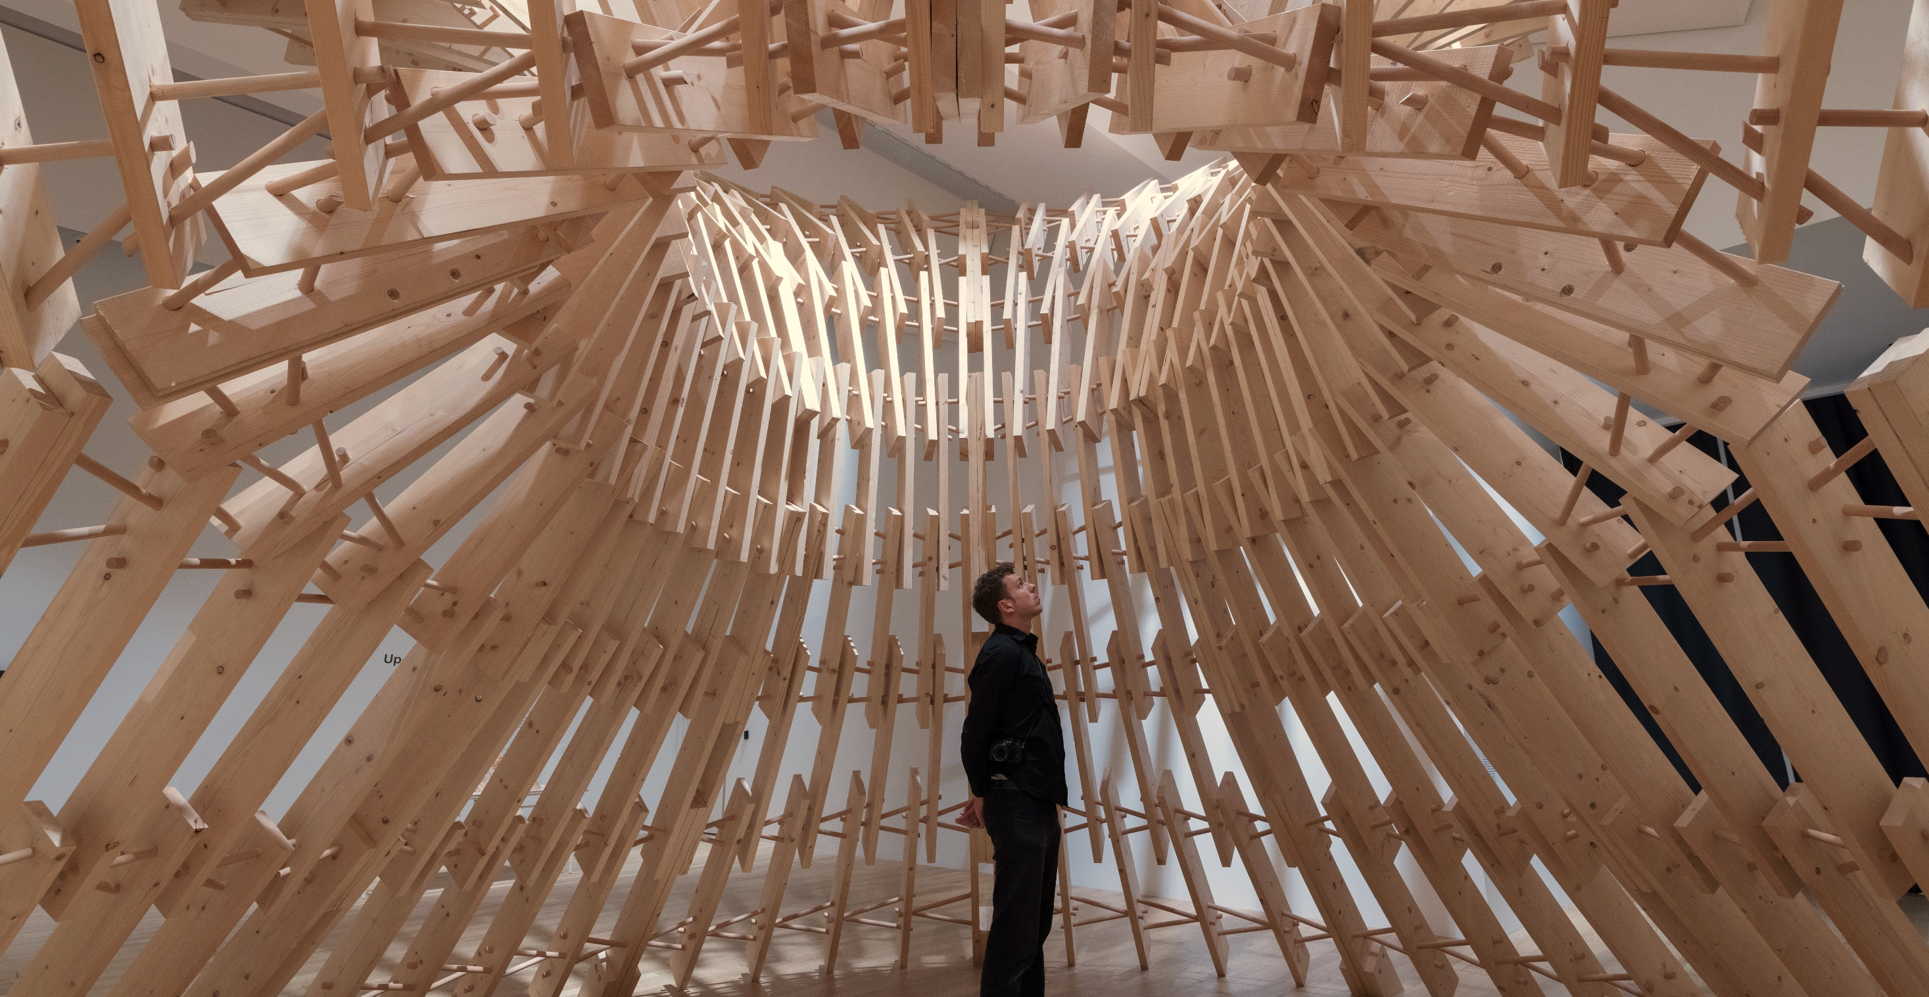
Up Sticks, V&A Dundee
Notes:
Wenn Studenten mit Hilfe digitaler Werkzeuge das hinbekommen, zeigt es doch was in der Industrie möglich sein sollte.

Slide 33
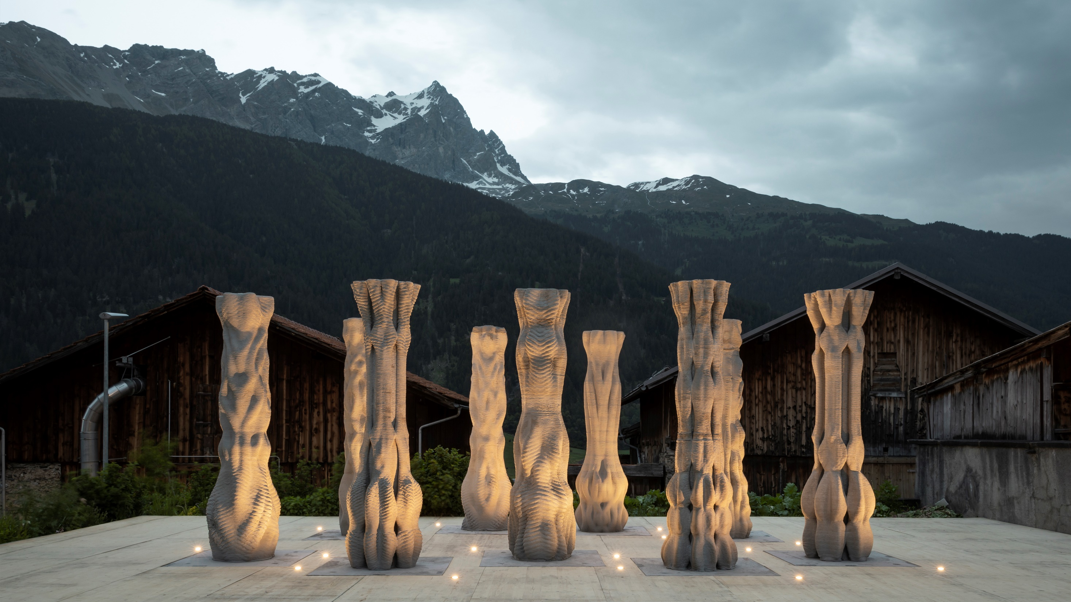
Concrete Choreography, Origen Festival 2019, Riom, CH

Slide 34
The MAS Year 2018-2019
Trimester 1 September 16. – December 20.
Digital Foundations
Trimester 2 January 06. – June 05.
Design and Fabrication Project 1 - GKR
Design and Fabrication Project 2 - DBT
Trimester 3 June 15. – September 25.
Research - Master Thesis

Slide 35
Generation Five
2019-20 Students: Maria Pia Assaf, Jomana Baddad, Frédéric Brisson, YuHung Chiu, Rémy Clemente, Ioulios Georgiou, Mahiro Goto, Anton Johansson, László Mangliár, Edurne Morales, Fatemeh Salehi, Emmanuelle Sallin, Indra Santosa, Eliott Sounigo, Dinorah Martinez Schulte, Chanon Techathuvanun, Ping Hsun Tsai
2018-19 Students: Yuta Akizuki, Jesus Barney, Ying Shiuan Chen, Chaoyu Du, Nik Eftekhar, Nicolas Feihl, Rahul Girish, Noor Khader, Sofia Michopoulou, Aya Shaker, Eleni Skevaki, Yoana Taseva, Keerthana Udaykumar, Jonas van den Bulcke, Wenqian Yang
2017-18 Students: Sahar Barzani, Fernando Cena, Georgia Chousou, Alexander Enz, Moonyoung Jeong, Frank Lin, Matteo Lomaglio, Ioanna Mitroupolou, Haruna Okawa, Rafael Pastrana, Francisco Regalado, Jetana Ruangjun, Jun Su, Nizar Taha, Yao Wang, Angela Yoo, Wu-Ru Zong
2016-17 Students: Marco Caprani, Samuel Cros, Rodrigo Diaz, Ahmed Elshafei, Federico Giacomarra, Hakim Hasan, Marirena Kladeftira, Iakovina Kontiza, Thodoris Kyttas, Matthias Leschok, Coralie Ming, Wataru Nagatomo, Matteo Pacher, Maria Pachi, Sambit Samant, Theodora Spathi, Dai-Syuan Wu
2015-16 Students: James Chenault, Shiu Lun Cheung, Jorge Christie Remy-Maillet, José De Carvalho Paixao, Alessandro Dell Endice, Larisa Gabor, Matthias Helmreich, Nicholas Hoban, Katrin Hochschuh, Wei Yu Hsiao, Jesús Medina Ibanez, Ioannis Mirtsopoulos, Pietro Odaglia, Federico Salvalaio, Fabio Scotto, Stavroula Tsafou, Anastasia Zaytseva
Notes:
Five generations of MAS DFAB Students. From the start it has been a truly international programme with students from different continents and different backgrounds. Some of the MAS students have stayed on and are now PhDs, Scientific Collaborators or even teach on this year’s programme – like Angela, Ioanna and Nizar – All the Alumni who stayed on in bolt. Those who started teaching on the MAS in Italics.

Slide 36
Generation Four - Statistics
2018-19 Students: Yuta Akizuki, Jesus Barney, Ying Shiuan Chen, Chaoyu Du, Nik Eftekhar, Nicolas Feihl, Rahul Girish, Noor Khader, Sofia Michopoulou, Aya Shaker, Eleni Skevaki, Yoana Taseva, Keerthana Udaykumar, Jonas van den Bulcke, Wenqian Yang
39 completed and eligible applications: 18 accept, out of which 6 decline 9 Master Degree, 9 Bachelor Degree (sur Dossier), 7 female, 11 male 18 Architects
16 students inscribed 9 Master Degree, 7 Bachelor Degree, 8 female, 7 male 16 Architects 6 Europe (ESP, 2 GR, BUL, CH, BE), 2 Americas (1 CAN, 1 MEX) 3 Middle East (1 KWT, 1UAE, 1LEB) 5 Asia (1 TWA, 1 IND, 2 CN, 1 JP) 1 Oceania (1 NZ)
1 Drop Out (First Week, Reason: English Skills)

Slide 37
Generation Five - Statistics
2019-20 Students: Maria Pia Assaf, Jomana Baddad, Frédéric Brisson, YuHung Chiu, Rémy Clemente, Ioulios Georgiou, Mahiro Goto, Anton Johansson, László Mangliár, Edurne Morales, Fatemeh Salehi, Emmanuelle Sallin, Indra Santosa, Eliott Sounigo, Dinorah Martinez Schulte, Chanon Techathuvanun, Ping Hsun Tsai
49 completed and eligible applications: 20 accept, out of which 7 decline 10 Master Degree, 10 Bachelor Degree (sur Dossier), 7 female, 13 male 1 Civil Engineer, 3 Designer, 16 Architects
17 students inscribed 8 Master Degree, 9 Bachelor Degree, 6 female, 11 male 1 Civil Engineer, 1 Designer, 15 Architects 6 Europe (FR 2, GR, HU, CH, SWE), 3 Americas (1 CAN, 2 MEX) 3 Middle East (1 JOR, 1IR, 1LEB) 5 Asia (2 TWA, 1 THA, 1 IND, 1 JP)
Jomana Baddad recipient of the E4D Continuing Education Scholarship
Notes:
You are the 5th generation of MAS DFAB Students. From the start it has been a truly international programme with students from different continents and different backgrounds. Some of the MAS students have stayed on and are now PhDs, Scientific Collaborators or even teach on this year’s programme – like Angela, Ioanna and Nizar
Let’s start with a presentation round, so we and you do get to know each other. If you could briefly introduce yourself, tell us a little bit about your background, and about your motivation to join the MAS DFAB, then this is the first step to form a new group, a new generation.

Slide 38
Generation Six - Statistics
2020-21 Students: Evgenia Angelaki, Sunny Anthraper, Pascal Bach, Yan Fen Chan, Wei-Ting Chen, Wei Chengyuan, Ilaria Giacomini, Simon Griffoen, Guillaume Jami, Lena Kitani, Artemis Maneka, Beril Önalan, Soni Pryank, Foteini Salveridou, Co Tsuruta, Carlos Wilkening
57 completed and eligible applications: 26 accept, out of which 9 decline 10 Master Degree, 16 Bachelor Degree (sur Dossier), 8 female, 18 male 26 Architects
17 students inscribed, 1 drop out during T1 13 Master Degree, 4 Bachelor Degree, 7 female, 10 male 17 Architects 10 Europe (FR, 4 GR, D, PL, CH, IT, NL), 1 Middle East (1 TK) 6 Asia (2 TWA, 2 IND, 1 JP, 1CN)
Pryank Soni recipient of the E4D Continuing Education Scholarship
Notes:
You are the 5th generation of MAS DFAB Students. From the start it has been a truly international programme with students from different continents and different backgrounds. Some of the MAS students have stayed on and are now PhDs, Scientific Collaborators or even teach on this year’s programme – like Angela, Ioanna and Nizar
Let’s start with a presentation round, so we and you do get to know each other. If you could briefly introduce yourself, tell us a little bit about your background, and about your motivation to join the MAS DFAB, then this is the first step to form a new group, a new generation.

Slide 39
Generation Seven - Statistics
2020-21 Students:
​60 applications: 18 accept, out of which 9 decline 11 Master Degree, 7 Bachelor Degree (sur Dossier), 7 female, 11 male 17 Architects, 1 Structural Engineer
5 Europe (3 GR, 2DE), 1 Middle East (1 IR) 9 Asia (3 TWA, 2 IND, 5CN) 2 Americas (US, MEX)
Notes:
You are the 5th generation of MAS DFAB Students. From the start it has been a truly international programme with students from different continents and different backgrounds. Some of the MAS students have stayed on and are now PhDs, Scientific Collaborators or even teach on this year’s programme – like Angela, Ioanna and Nizar
Let’s start with a presentation round, so we and you do get to know each other. If you could briefly introduce yourself, tell us a little bit about your background, and about your motivation to join the MAS DFAB, then this is the first step to form a new group, a new generation.

